Slide 1

Resistive Silicon Detector: the “1 μm” project
Resistive Read-out in Silicon Detector offers the possibility to reach unprecedented position resolution using large pixels and thin sensors
Aide Memoire: position determination, sensor accuracy, material budget
Requests at future colliders
Resistive readout in silicon detectors
Charge sharing: RSD main formula
Reconstruction method
Results: laser, beam test ➔ All results obtained using RSD1 from FBK
Read-out electronics
Application of Machine learning algorithms
Future directions

Slide 2

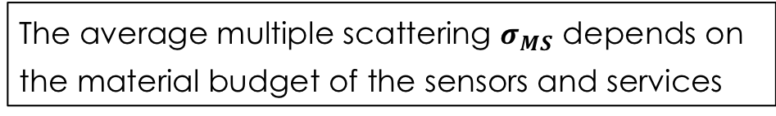

Impact parameter resolution in silicon detector
Th precision of a sensor, $σ_{Sensor, }$depends upon two factors:
$$σ_{Sensor}^{2}=σ_{x}^{2}+σ_{MS}^{2}$$
The accuracy of the single hit $σ_{x}$
The average multiple scattering $σ_{MS}$ depends on the material budget of the sensors and services
Smallest possible $σ_{x} :$ very accurate sensors
Smallest possible $σ_{MS}:v$ery thin sensors
The sensors need to be very accurate and very thin

Slide 3

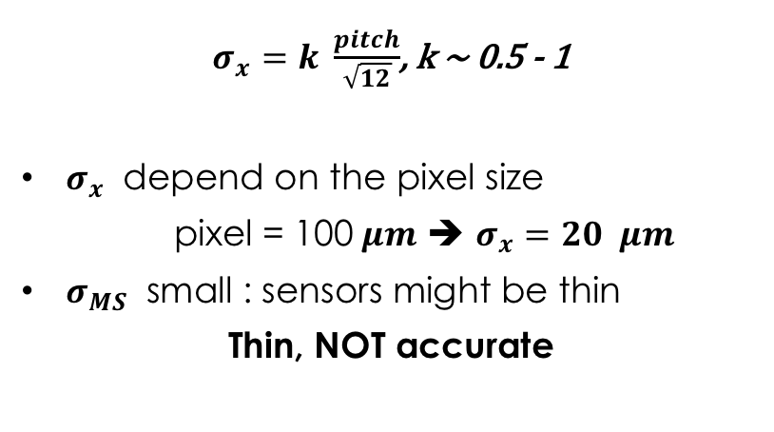
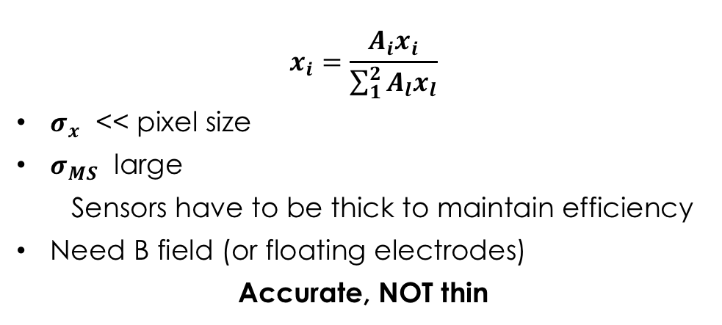
Sensor accuracy $σ_{x}$ and readout
Binary readout
where the only information is hit/miss (0,1)
Analog readout
where the amplitude of the signal is recorded
Pixel size
thin sensor
---
++++
---
--
++
+++
++++
-
-
-
Thick sensor
Lorentz angle
$$θ$$
$$x_{i}=\frac{A_{i}x_{i}}{\sum_{1}^{2}{A_{l}x_{l}}}$$
$σ_{x}$ << pixel size
$σ_{MS}$ large
  Sensors have to be thick to maintain efficiency
Need B field (or floating electrodes)
Accurate, NOT thin
$σ_{x}=k \frac{pitch}{\sqrt{12}}$, k ~ 0.5 - 1
$σ_{x}$ depend on the pixel size
pixel = 100$μm$ ➔ $σ_{x}=20 μm$
$σ_{MS}$ small : sensors might be thin
Thin, NOT accurate
The sensors are either very accurate OR very thin

Slide 4
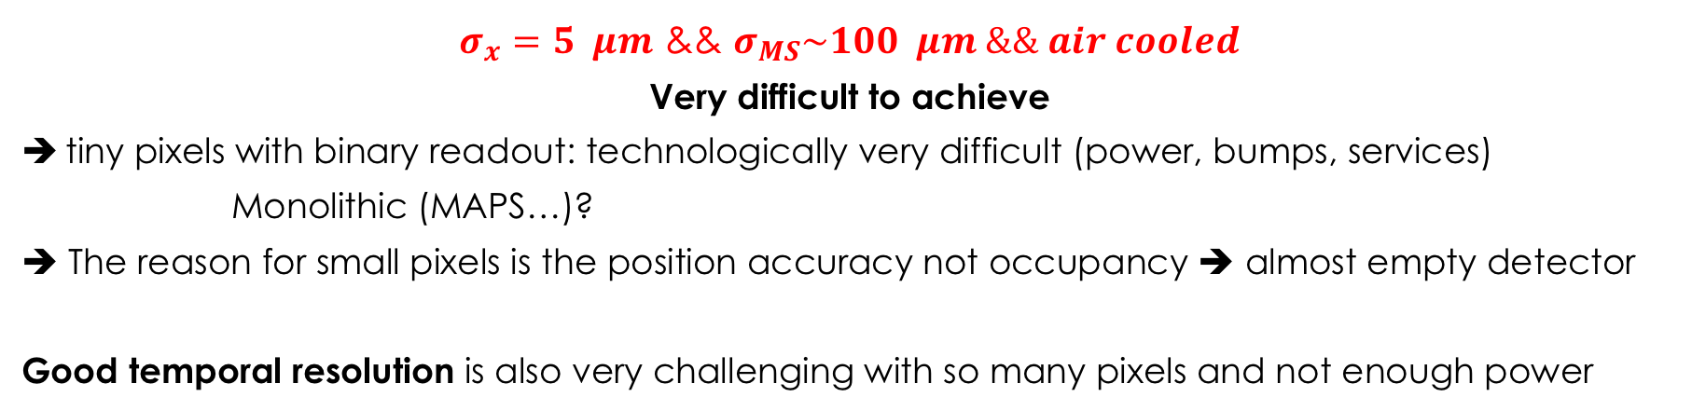
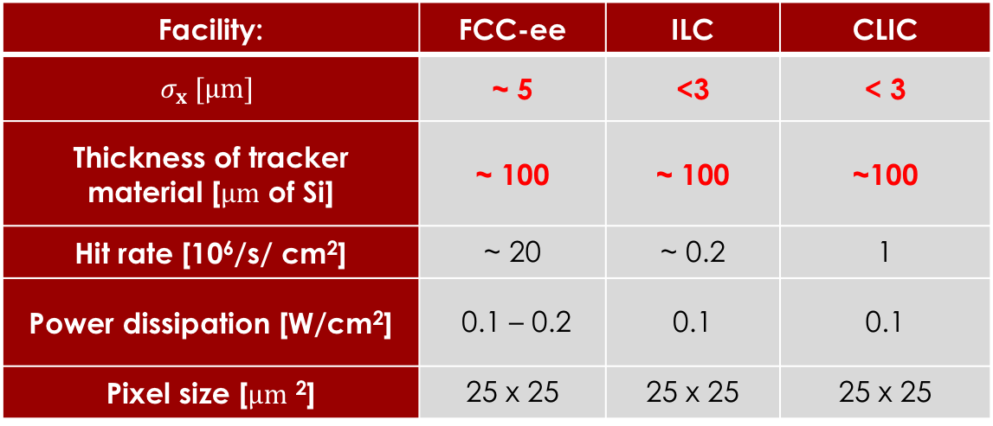
Request at future accelerators
Facility: | FCC-ee | ILC | CLIC
$$σ_{x} [μm]$$ | ~ 5 | <3 | < 3
Thickness of tracker material [$μm$ of Si] | ~ 100 | ~ 100 | ~100
Hit rate [10⁶/s/ cm²] | ~ 20 | ~ 0.2 | 1
Power dissipation [W/cm²] | 0.1 – 0.2 | 0.1 | 0.1
Pixel size [$μm$ ²] | 25 x 25 | 25 x 25 | 25 x 25
$σ_{x}=5 μm$ && $σ_{MS}\sim 100 μm \&\& air cooled$
Very difficult to achieve
tiny pixels with binary readout: technologically very difficult (power, bumps, services)
Monolithic (MAPS…)?
➔ The reason for small pixels is the position accuracy not occupancy ➔ almost empty detector
Good temporal resolution is also very challenging with so many pixels and not enough power

Slide 5
Signal formation in DC-coupled silicon sensor
The e/h are drifting, producing direct charge induction in the n++ layer (Ramo’s theorem)
Metal pad
n++ electrode
-+
-+
-+
-+
-+
-+
p-bulk
p++ electrode

Slide 6
Resistive readout
1) Extended the n++ electrode over the whole Si surface
2) Make the n++ electrode resistive ➔ n+
3) Add AC-coupling readout
AC coupling oxide
Resistive n+ electrode
p++ electrode

Slide 7
Signal formation in resistive readout
The signal is formed on the n+ electrode ==> no signal on the AC pads
The AC pads offer the smallest impedance to ground for the fast signal
The signal discharges to ground
short RC
short RC
Fast signal
Fast signal
long RC
long RC
-+
-+
-+
-+
-+
-+
In resistive readout the signal is naturally shared among pads (4-6) without the need of B field or floating pads
Problem: sharing a small signal leads to inefficiency

Slide 8
Gain in Silicon detectors
Gain in silicon detectors is commonly achieved in several types of sensors. It’s based on the avalanche mechanism that starts in high electric fields: V ~ 300 kV/cm
Charge multiplication
Gain:
= strong E dependance
~ 0.7 pair/μm for electrons,
~ 0.1 for holes
ΔV ~ 300 kV/cm
-
-
-
-
-
-
-
Concurrent multiplication of electrons and holes generate very high gain
+
+
+
+
+
-
-
-
-
-
-
Silicon devices with gain:
APD: gain 50-500
SiPM: gain ~ 10⁴
-
+
+
+
+
+
+
-
+
-
-
-
+

Slide 9
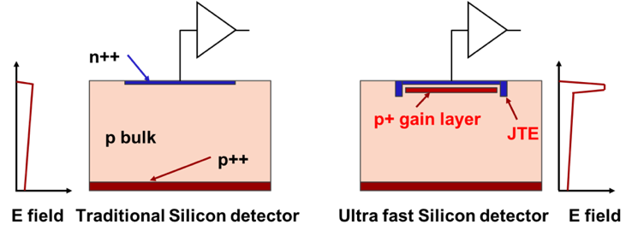
Low gain avalanche diode (LGAD)
zoom
Drift area with gain
0.5 – 2 μm long
The gain layer:
a parallel plate capacitor with high field
The LGAD sensors, as proposed and first manufactured by CNM
(National Center for Micro-electronics, Barcelona):
High field obtained by adding an extra doping layer
E ~ 300 kV/cm, closed to breakdown voltage
The low-gain mechanism, obtained with a moderately doped p-implant, is the defining feature of the design.
The low gain allows segmenting and keeping the shot noise below the electronic noise, since the leakage current is low.

Slide 10
Combining internal sharing and internal gain
1) Extended the n++ electrode over the whole Si surface
2) Make the n++ electrode resistive ➔ n+
3) Add AC-coupling readout
4) Add internal gain to maintain 100% efficiency even with signal sharing
5) Make the sensor thin to reduce material budget and enhance timing performance
AC coupling oxide
Resistive n+ electrode
50 μm
Gain layer
p++ electrode

Slide 11
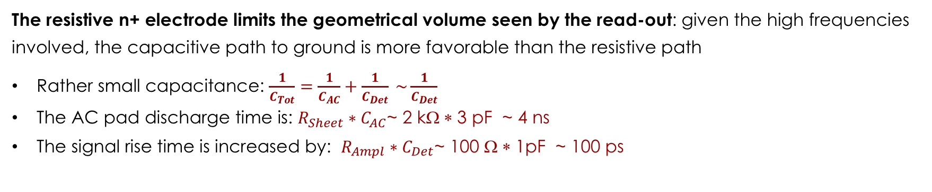
Resistive readout: why does it work?
Signal low impedance path to ground
AC coupling
C _{AC}
R_{Ampl}
Metal pads
Signal high impedance path to ground
R_{Sheet}
gain layer
n+ electrode
C _{Det}
p++ electrode
Volume seen by the frontend
The resistive n+ electrode limits the geometrical volume seen by the read-out: given the high frequencies involved, the capacitive path to ground is more favorable than the resistive path
Rather small capacitance: $\frac{1}{C_{Tot}}=\frac{1}{C_{AC}}+\frac{1}{C_{Det}} \sim \frac{1}{C_{Det}}$
The AC pad discharge time is: $R_{Sheet}∗C_{AC}$~ 2 kΩ ∗ 3 pF ~ 4 ns
The signal rise time is increased by: $R_{Ampl}∗C_{Det}$~ 100 Ω ∗ 1pF ~ 100 ps

Slide 12
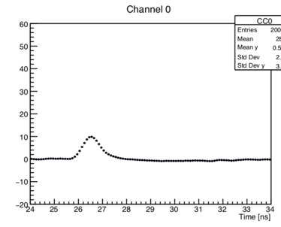
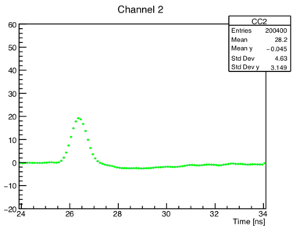
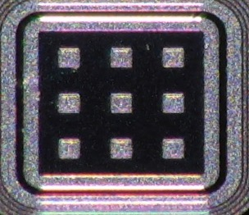
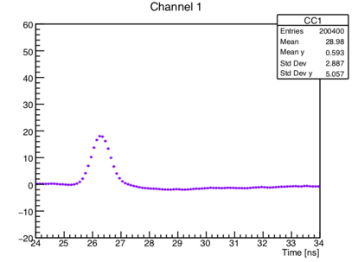
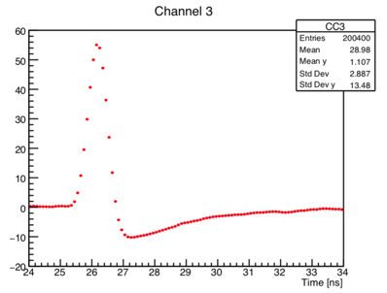
Example of signal sharing
P 1
Pad 1
60
40
20
0
-20
60
40
20
0
-20
Pad 1
Pad 2
Amplitude [mV]
50-mm thick RSD,
Gain ~ 20
0 2 4 6 8 10
0 2 4 6 8 10
1
2
60
40
20
0
-20
60
40
20
0
-20
Pad 3
Pad 4
3
4
Amplitude [mV]
0 2 4 6 8
0 2 4 6 8 10
Time [ns]
Time [ns]
The laser is shot at the position of the red dot: the signal is seen in 4 pads

Slide 13
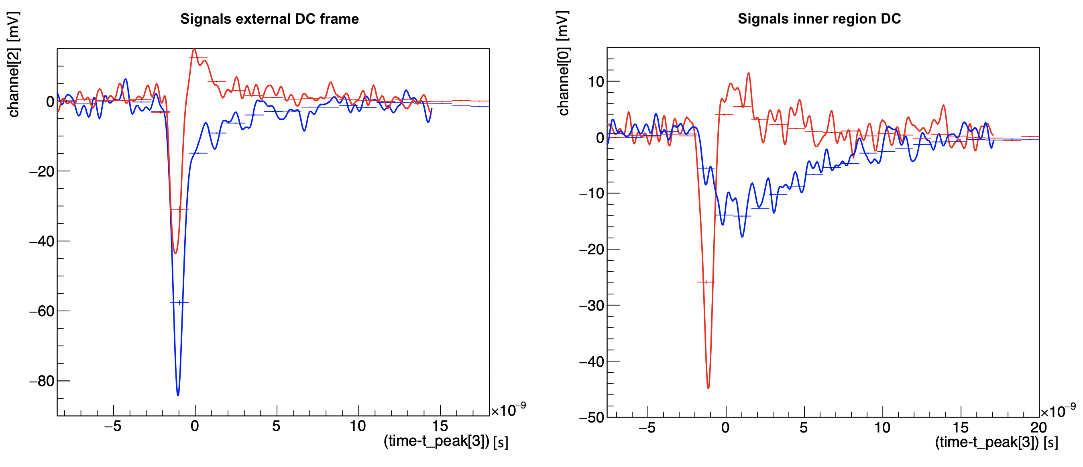
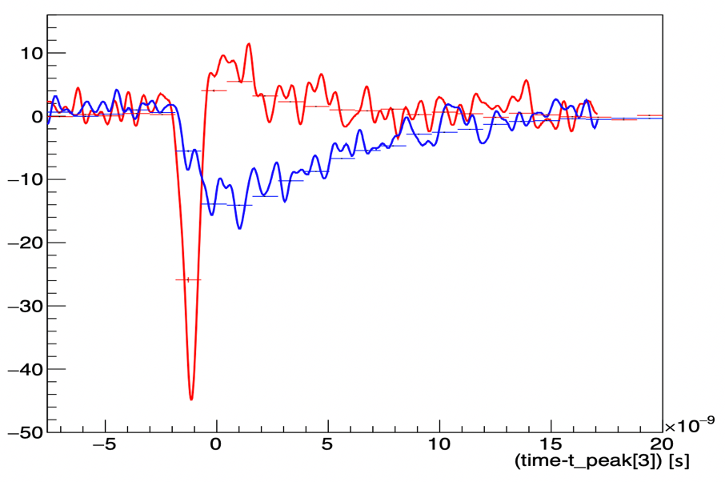
AC and DC signal at beam test
Particle impact point in the outer sensor region
Particle impact point in the inner sensor region
AC pad
10
AC pad
0
Signal [mV]
Signal [mV]
0
-20
DC pad
-10
-40
-20
DC pad
-60
Fast signal on the AC
and DC pad
-30
Fast signal only on the AC pad
-40
Fast signal:
visible only on the AC pads
-80
-50
0 5 10 15 20
0 5 10 15 20 25
Time [ns]
Time [ns]
DC contact

Slide 14



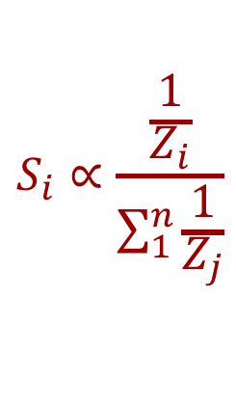




Charge sharing in RSD
The signal sees several impedances in parallel, and it is split according to Ohm’s law.
Each pad gets a share of the total signal, exactly as in a current divider
$$S_{i}∝\frac{\frac{1}{Z_{i}}}{\sum_{1}^{n}{\frac{1}{Z_{j}}}}$$
1
2
$$Z_{1}$$
$$Z_{2}$$
$$Z_{3}$$
$$Z_{4}$$
$$Z_{1}$$
$$Z_{2}$$
3
$$Z_{3}$$
$$Z_{4}$$
4

Slide 15
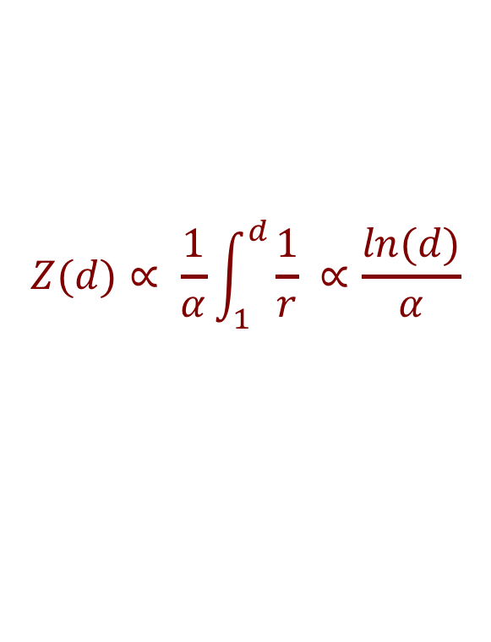


How to calculate Z_{i}
The impedance Z seen by a propagating signal does not increase linearly with the distance r since the signal spreads on a larger area
The resistance R per unit distance decreases as the circumference C becomes larger
$$Z(r)∝\frac{dr}{αr}$$
The impedance Z up to radius r is therefore:
_{r}
1
$$Z(d)∝ \frac{1}{α}\int_{1}^{d}{\frac{1}{r} ∝\frac{ln(d)}{α} }$$
R
R
R
R
R
R
R
R
where $α$ is the angle (larger pad, smaller resistance)
R
R
$$α$$
Hit position

Slide 16


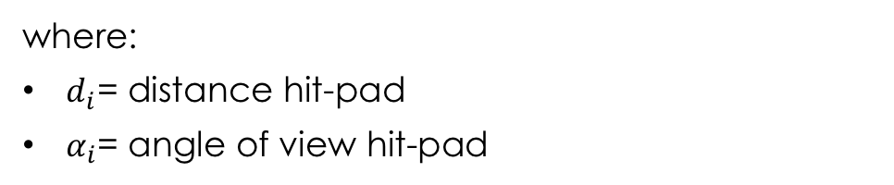
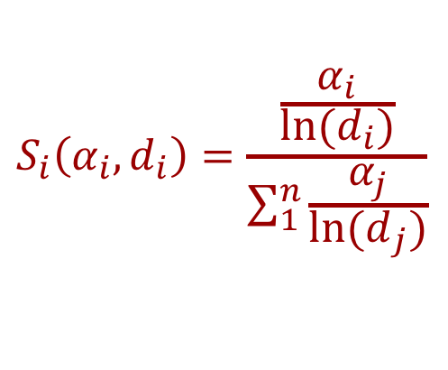






RSD main formula
The fraction of signal seen in each pad is:
$$S_{i}\left(α_{i},d_{i}\right)=\frac{\frac{α_{i}}{{ln⁡(d}_{i})}}{\sum_{1}^{n}{\frac{α_{j}}{{ln⁡(d}_{j})}}}$$
Hit position
$$Z_{1}\left(d_{1}, α_{1}\right)$$
$$Z_{2}\left(d_{2}, α_{2}\right)$$
$$Z_{3}\left(d_{3}, α_{3}\right)$$
$$Z_{4}\left(d_{4}, α_{4}\right)$$
where:
$d_{i}$= distance hit-pad
$α_{i}$= angle of view hit-pad
1
2
Important points:
The signal seen in a pad depends upon how many other pads are nearby
A signal can be seen by 2,3 or 4 pads, depending on the hit location
$$Z_{1}$$
$$Z_{2}$$
$$Z_{3}$$
$$Z_{4}$$
3
4

Slide 17
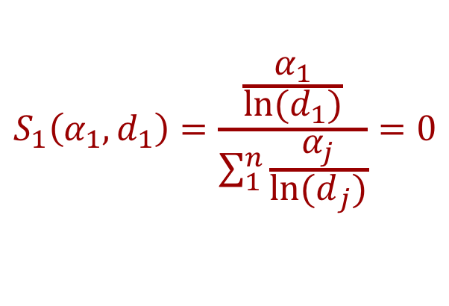

RSD main formula – floating pads
$$S_{1}\left(α_{1},d_{1}\right)=\frac{\frac{α_{1}}{{ln⁡(d}_{1})}}{\sum_{1}^{n}{\frac{α_{j}}{{ln⁡(d}_{j})}}}=0$$
Hit position
$$Z_{1}\left(d_{1}, α_{1}\right)$$
$$Z_{2}\left(d_{2}, α_{2}\right)$$
$$Z_{3}\left(d_{3}, α_{3}\right)$$
$$Z_{4}\left(d_{4}, α_{4}\right)$$
A floating pad does not contribute to the signal sharing, there is no path to ground, i.e., no current flow.
1
2
$$Z_{1}$$
$$Z_{2}$$
$$Z_{3}$$
$$Z_{4}$$
3
4

Slide 18


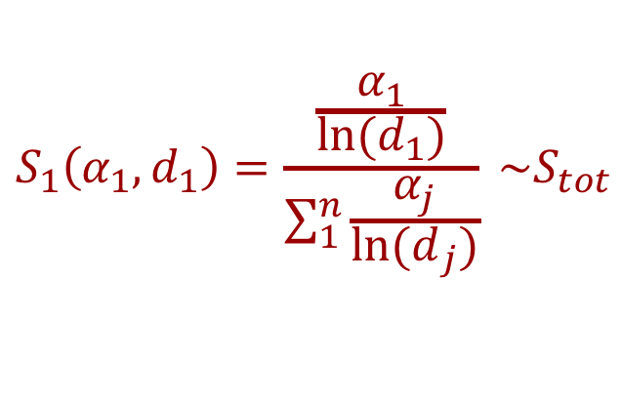


RSD main formula – Hit on metal
$$S_{1}\left(α_{1},d_{1}\right)=\frac{\frac{α_{1}}{{ln⁡(d}_{1})}}{\sum_{1}^{n}{\frac{α_{j}}{{ln⁡(d}_{j})}}} \sim S_{tot}$$
Hit position
$$Z_{1}\left(d_{1}, α_{1}\right)$$
$$Z_{2}\left(d_{2}, α_{2}\right)$$
$$Z_{3}\left(d_{3}, α_{3}\right)$$
$$Z_{4}\left(d_{4}, α_{4}\right)$$
When the hit is on the metal, the impedance to that pad is ~ zero, so the whole signal is in one pad.
Consequences:
In the following, signal sharing refers to the area without metal
Metal pads need a special design
$$Z_{1}$$
1
2
$$Z_{2}$$
$$Z_{3}$$
$$Z_{4}$$
3
4

Slide 19
RSD main formula in motion

Slide 20
RSD main formula in motion

Slide 21
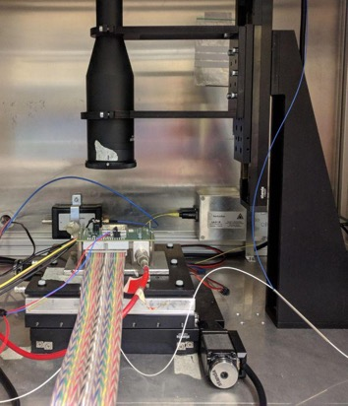
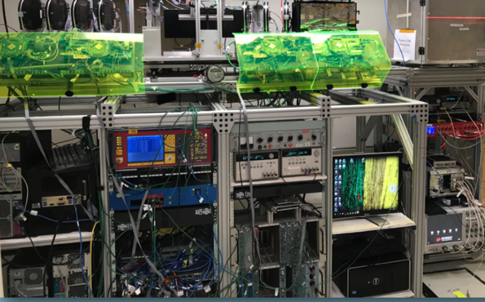
Experimental data: Laser and beam test
The laser studies presented here are obtained using a “Particular” laser TCT set-up
Sensors are glued on a 16-channel read-out board.
The laser is shot in various position via an x-y-z micrometric stage
The beam test results have been obtained at FNAL, in collaboration with the FNAL CMS-Timing ETL team
120 GeV/c proton beam
Precise timing determination (~ 10 ps)
Fairly precise tracking system (~ 35-40 um)
The signals are recorded with a digital oscilloscope (20-40 GS/s, 2-4 GHz BW) for offline analysis

Slide 22
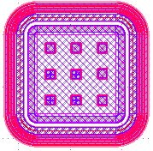
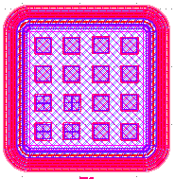




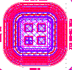

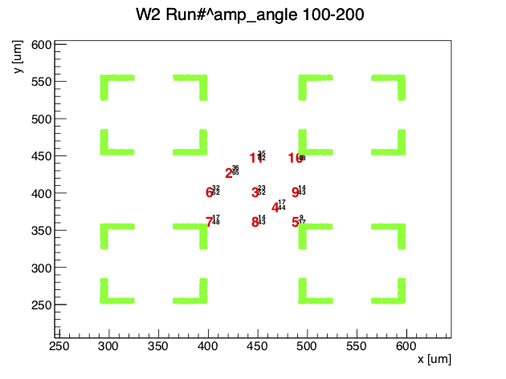
Structures tested (metal-pitch)
The FBK production RSD1 yielded many samples, of several geometries, exploring the interplay of n+ resistivity, dielectric thickness, metal pad, and pitch
50-100
70-100
100-200
150-200
150-300
200-300
200-500
300-500
Each sensor was tested with the laser TCT set-up, shining the laser spot (~ 10 um) in several positions and recording the signals seen by the 4 adjacent pads.
The runs were repeated at 3-4 values of gain for each geometry
Example of laser positions

Slide 23
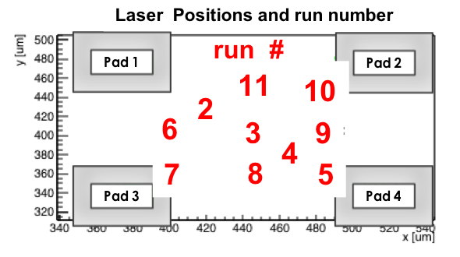
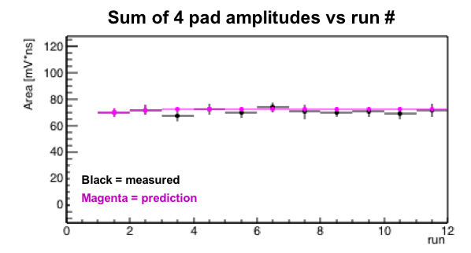
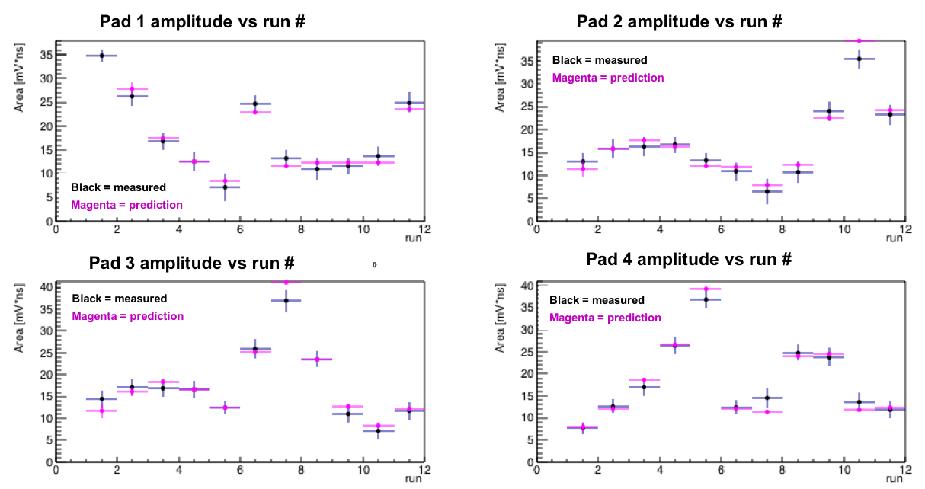


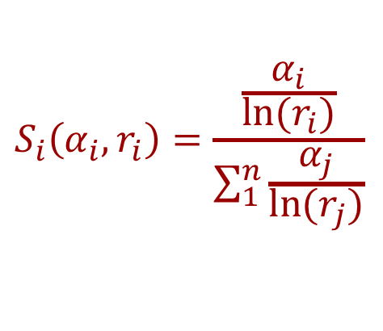


Signal amplitudes as a function of positions – 4 pads
The amplitudes in the 4 pads change together, in a “coordinated way”, as they should in a current divider.
Hit position
$$Z_{1}$$
$$Z_{2}$$
$$Z_{3}$$
$$Z_{4}$$
$$S_{i}\left(α_{i},r_{i}\right)=\frac{\frac{α_{i}}{{ln⁡(r}_{i})}}{\sum_{1}^{n}{\frac{α_{j}}{{ln⁡(r}_{j})}}}$$
Wrap-up:
RSD works as a current divider
The signal is naturally shared among pads
The RSD main formula works well
  ➔ no free parameters, the magenta points are an absolute prediction
The total amplitude is fairly constant

Slide 24
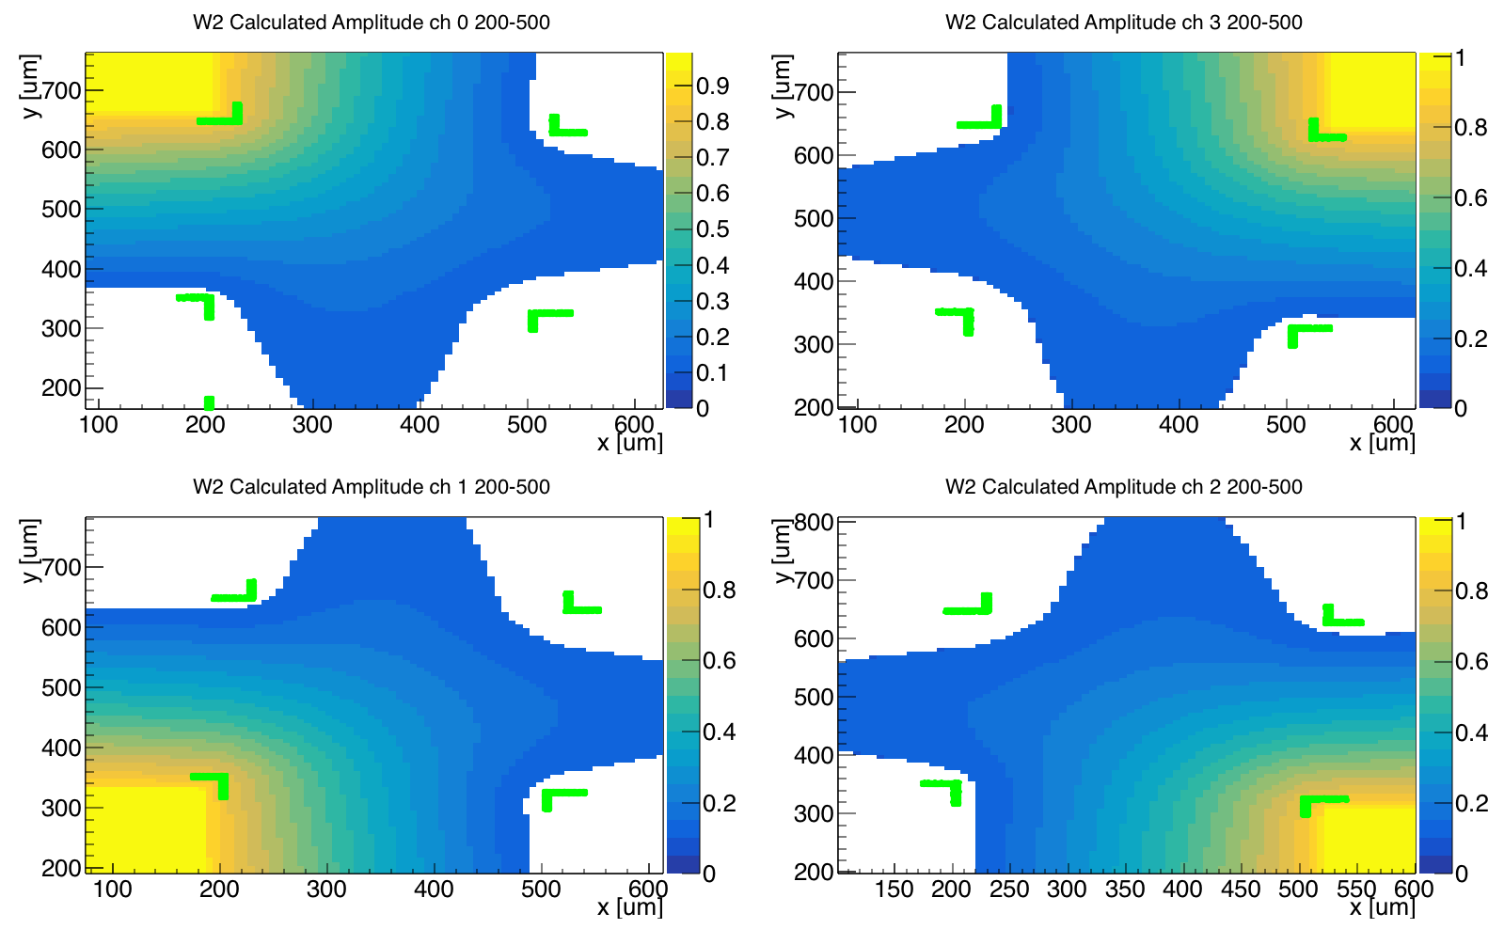
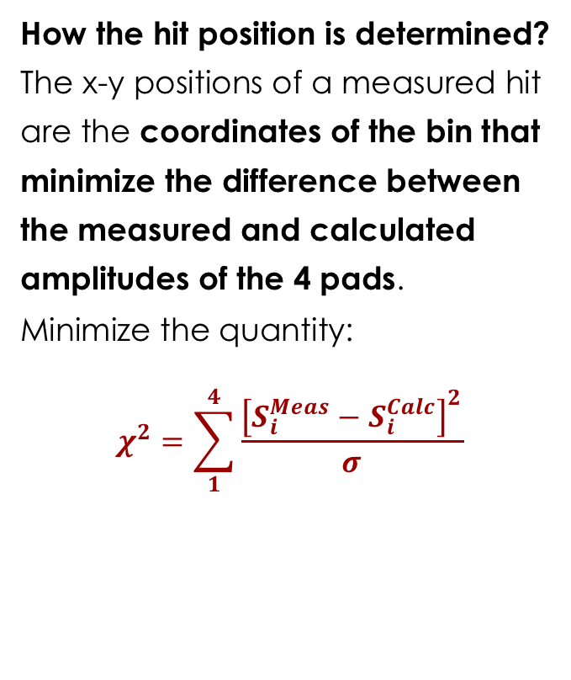
Position reconstruction method
Basic principle: the amplitudes seen by the pads define a unique x-y point
The RSD main formula allows computing for each
x-y point the 4 amplitudes seen by the pads
A particle hits in a given position, with relative amplitude in the 4 pads 0.5,0.2,0.1,0.2
0.5
0.20
How the hit position is determined?
The x-y positions of a measured hit are the coordinates of the bin that minimize the difference between the measured and calculated amplitudes of the 4 pads.
Minimize the quantity:
$$χ^{2}=\sum_{1}^{4}{\frac{{\left[S_{i}^{Meas}−S_{i}^{Calc}\right]}^{2}}{σ}}$$
0.20
0.1

Slide 25
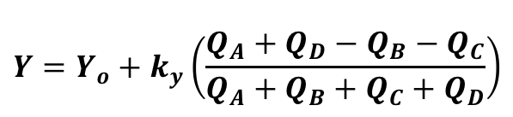
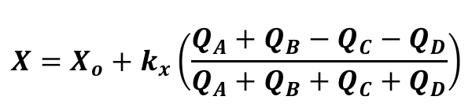

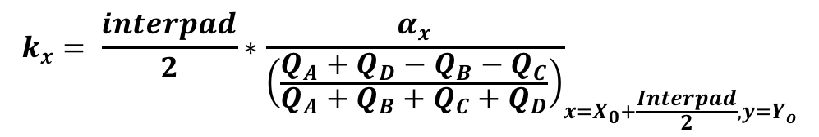
RSD as a Discretized Positioning Circuit
interpad
D
A
$$X=X_{o}+k_{x}\left(\frac{Q_{A}+Q_{B}−Q_{C}−Q_{D}}{Q_{A}+Q_{B}+Q_{C}+Q_{D}}\right)$$
y
$$Y=Y_{o}+k_{y}\left(\frac{Q_{A}+Q_{D}−Q_{B}−Q_{C}}{Q_{A}+Q_{B}+Q_{C}+Q_{D}}\right)$$
x
$${(X}_{o},Y_{o})$$
$$k_{x}= {\frac{interpad}{2}∗\frac{α_{x}}{\left(\frac{Q_{A}+Q_{D}−Q_{B}−Q_{C}}{Q_{A}+Q_{B}+Q_{C}+Q_{D}}\right)}}_{x=X_{0}+\frac{Interpad}{2},y=Y_{o}}$$
C
B
RSD is a hybrid resistors/capacitors DPC circuit
The reconstruction method uses only the signals in the 4 pads to reconstruct the hit position
no need for a analytical sharing law.
k_{x,y} = imbalance parameter along x or y
  Maximum value of the charge imbalance within the pixel
  Needs to be determined experimentally for each geometry

Slide 26
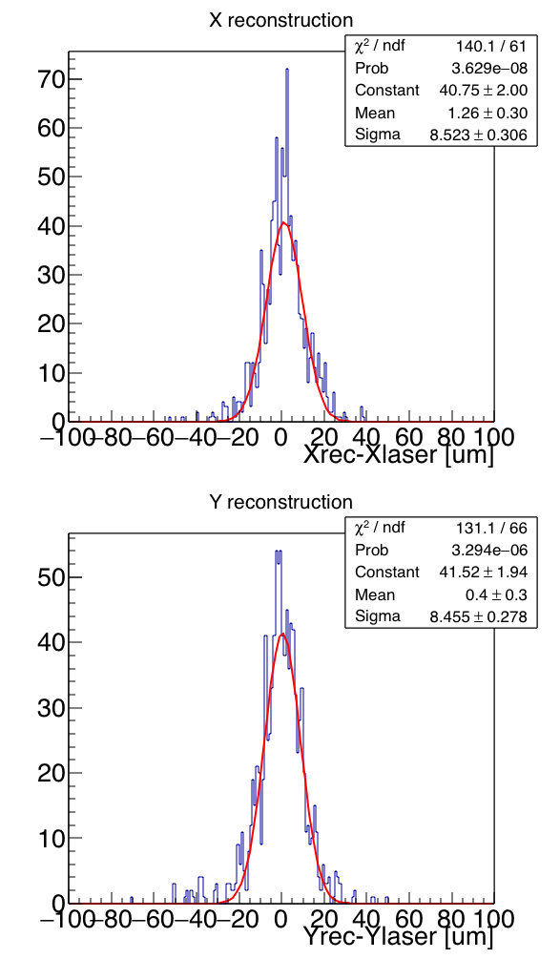
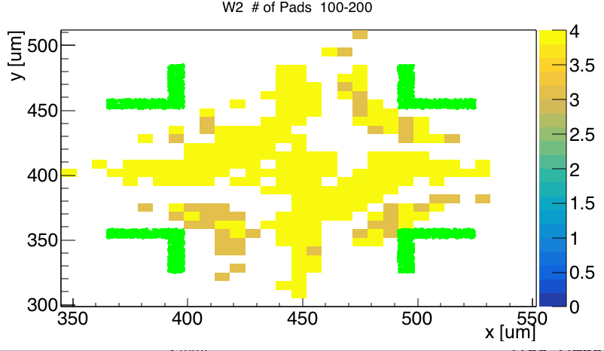
Laser study: position resolution
Shooting the laser in many positions, the spatial precision can be evaluated. This is done by comparing the position reconstructed using the look-up table to the known laser position.
Geometry: 100 Metal, 200 pitch
Shooting position and# of pads used in the reconstruction
Resolution ~ 8.5 um
Gain ~ 17

Slide 27
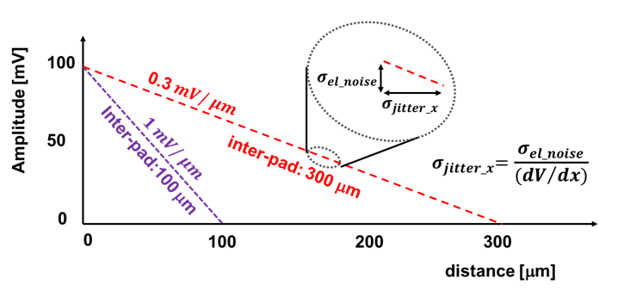
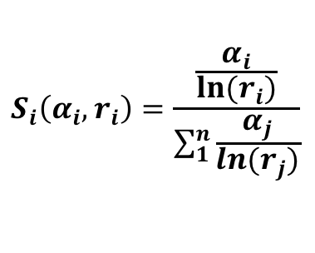

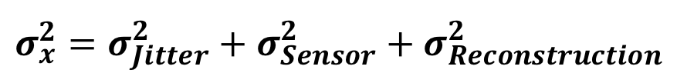

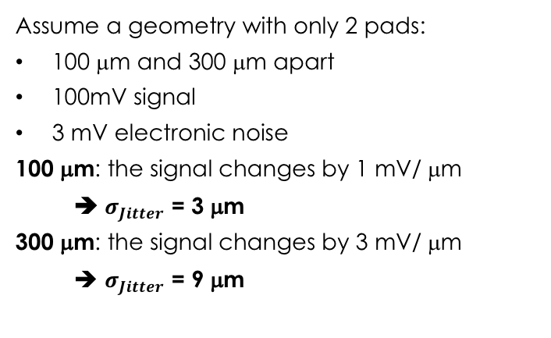
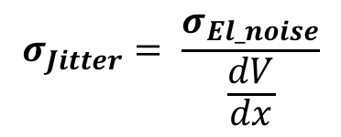
Spatial resolution in resistive readout
$$σ_{x}^{2}={σ_{Jitter}^{2}+σ}_{Sensor}^{2}+σ_{Reconstruction}^{2}$$
$$σ_{Jitter}= \frac{σ_{El_noise}}{\frac{dV}{dx}}$$
$$σ_{Sensor}$$
$$σ_{Recontruction}$$
Electronic noise
Sensor non-uniformity
Algorithm
Assume a geometry with only 2 pads:
100 μm and 300 μm apart
100mV signal
3 mV electronic noise
100 μm: the signal changes by 1 mV/ μm
➔ $σ_{Jitter}$ = 3 μm
300 μm: the signal changes by 3 mV/ μm
➔ $σ_{Jitter}$ = 9 μm
$$S_{i}\left(α_{i},r_{i}\right)=\frac{\frac{α_{i}}{{ln⁡(r}_{i})}}{\sum_{1}^{n}{\frac{α_{j}}{{ln⁡(r}_{j})}}}$$
hit
50%
50%
For equal resistivity, 50%-50% sharing indicates the hit is in the middle
If the predicted sharing is incorrect, the reconstructed position is shifted.
DPC: RSD might not be a perfect DPC, yielding to systematic errors.
hit
40%
60%
reconst.
If the resistivity is not uniform, the reconstruction shifts the point closer to the smaller resistivity

Slide 28
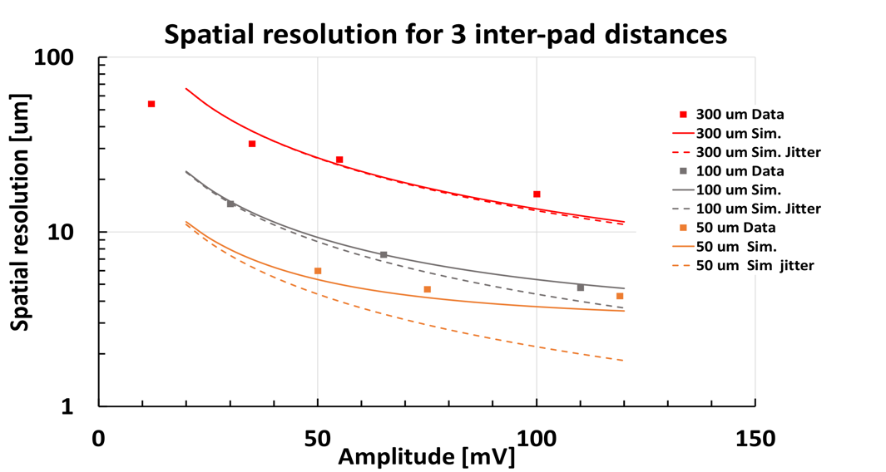

Laser study: position resolution as a function of amplitude
The spatial resolution improves with signal amplitude, plateauing at about 5 um
Important points:
At low signal amplitude, the resolution is dominated by jitter
  ➔ Low noise electronics
Larger geometries have worse position resolution
  ➔ need high gain
At high amplitude, the resolution is limited by systematics such as the precision of the amplitude reconstruction and the use of the RSD main formula.
Gain = 20
Gain = 10
Interpad | Measured Resolution
300 um | 17 ± 0.1 (exp.) ± 3.5 (syst.) um
100 um | 5.5 ± 0.1 (exp.) ± 3.5 (syst.) um
50 um | 4 ± 0.1 (exp.) ± 3.5 (syst.) um
$$σ_{x}^{2}={σ_{Jitter}^{2}+σ}_{Sensor}^{2}+σ_{Reconstruction}^{2}$$

Slide 29
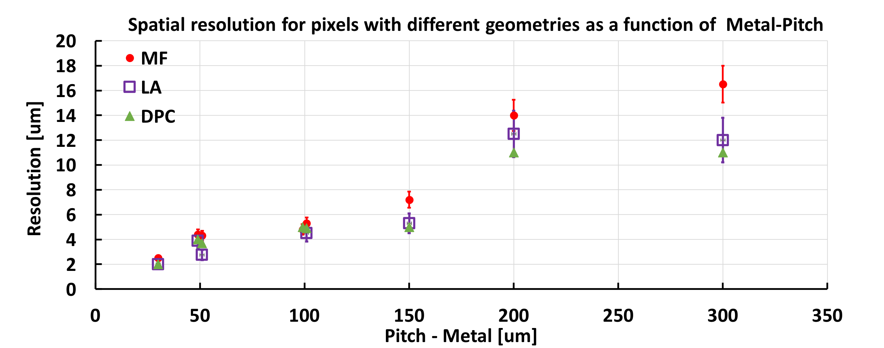
Laser study: position resolution as a function of pixel geometry
150 - 300
50 -100
150 - 200
100 - 200
300 - 500
200 - 500
70-100
RSDs reach a spatial resolution that is about 5% of the inter-pad distance

Slide 30
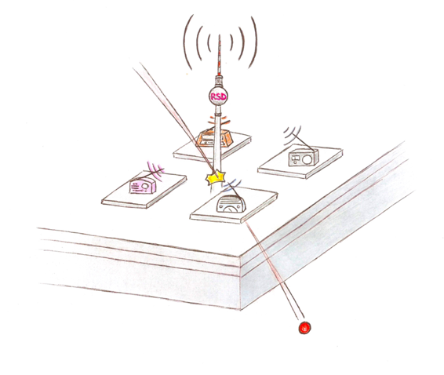
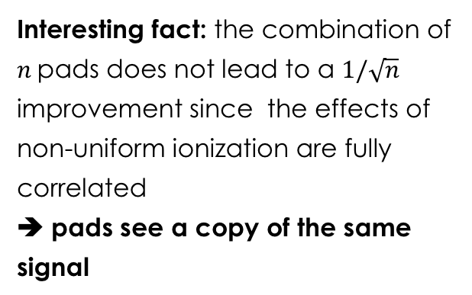
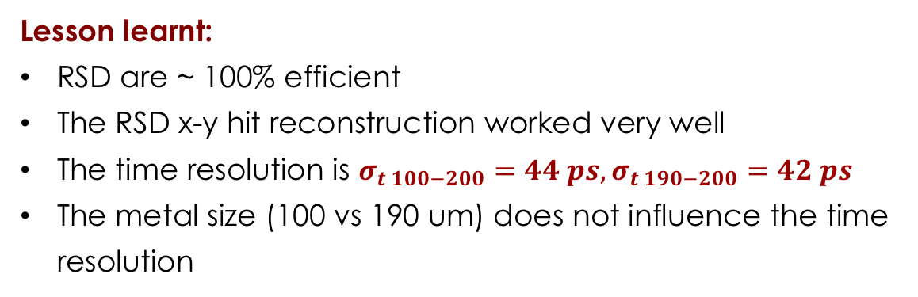
FNAL beam test results
All details in: M. Tornago, 36th RD50 “Latest results on RSD spatial and timing resolution https://indi.to/2cGQy
Data taken with RSD 3x3 100-200 and 190-200 geometries
Lesson learnt:
RSD are ~ 100% efficient
The RSD x-y hit reconstruction worked very well
The time resolution is $σ_{t 100−200}=44 ps,σ_{t 190−200}=42 ps$
The metal size (100 vs 190 um) does not influence the time resolution
100 - 200
190 - 200
~42 ps
Interesting fact: the combination of $n$pads does not lead to a $1/\sqrt{n}$ improvement since the effects of non-uniform ionization are fully correlated
➔ pads see a copy of the same signal
~44 ps

Slide 31
ASIC for RSD
Very important point: in hybrid technology (sensor bump-bonded to the ASIC), the area available for each read-out channel is identical to the pixel area
Assuming a goal of ~ 5 mm spatial resolution,
the RSD pitch can be 150-200 μm
At least a factor of 10-20 more space than using binary readout
Can concentrate the power available for that area into a single channel
The needed circuits for timing might actually fit
ASIC
Sensor
ASIC channel area
150 x 150 um²
Example:
TDC evolution
?
130 nm:
70 x 150 micron
65 nm:
40 x 60 micron
28 nm:
~20 x 30 micron

Slide 32
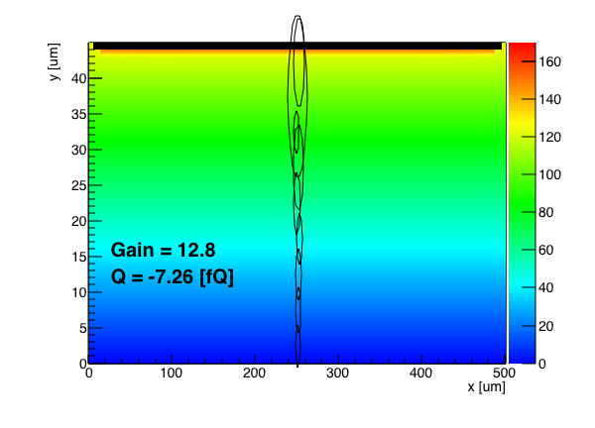
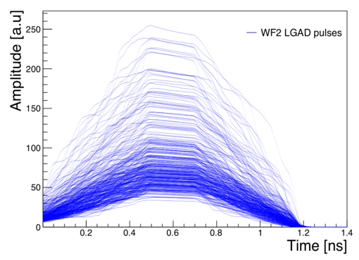

RSD intrinsic time resolution
The AC readout scheme does not change the basic timing properties of UFSD:
Simulation of signals in 50-um RSD
$$σ_{t}^{2}={\left(\frac{Noise}{dV/dt}\right)}^{2}+{\left(∆ionization\right)}^{2}$$
Shape distortion
Amplitude variation
Non-uniform ionization
“Jitter” term
Here enters everything that is “Noise” and the steepness of the signal
Non uniform ionization:
1) Amplitude variation:
variation in the total charge
2) Shape distortion:
Signal Shape distortion ➔Minimum time resolution
RSD minimum temporal resolution improves for thinner sensors:
40 ps @ 45 um ➔ 20 ps @ 25 um
However, the total charge is less (10fC➔5 fC) and the electronics might not be able to exploit this improvement

Slide 33
RSD material budget and time resolution
The active thickness of RSD sensor is rather small ~ 50 um.
In the present prototypes, the active part is attached to a thick “handle wafer”
There is a clear path leading to < 100 μm material:
ASIC
~1 μm glue
~150 μm
~50 μm
ASIC
25 um
~50 μm
50 um
ASIC
50 μm
25 μm
50 μm
Silicon beam
~200 μm
Thinned handle wafer:
  500 um ➔ 10-20 um
Thinned handle wafer:
500 um ➔ 10-20 um
Thinned active area:
50 um ➔ 25 um
50 ps ➔ 25 ps
Present design: no material budget optimization

Slide 34

Summary of RSD characteristics
In AC-LGAD/RSD signal sharing happens on the surface, in the n+ layer, and not during the e/h drift, opening the possibility of having very small $σ_{MS}$ and $σ_{x}$
The AC-LGAD/RSD design combines internal signal sharing with internal gain
RSDs have:
  Very good position resolution due to internal sharing (< 5 μm)
  Very good temporal resolution due to internal gain (~20-30 ps)
  100% fill factor due to the continuous n+ implant
RSDs can be made very thin (~ 30 μm)
The pixel size can be kept large: 200x200 μm² achieves 5 μm position resolution

Slide 35
Future directions
Reconstruction algorithm: use of machine learning
Position resolution: design optimization
RSD strip detector: design optimization
Far out designs: where the wild things are
RSD field of applications

Slide 36




Machine Learning applied to RSD
All details in: F. Siviero, 36th RD50 “Position reconstruction using machine learning algorithms applied to Resistive Silicon Detectors (RSD)”
Each of the signals in an RSD event carries a lot of information (amplitude, derivative, width) that can be exploited to perform very accurate x-y-t reconstruction.
Analytic sharing laws are not able to capture all this information
Need to use
Multiple sampling front-end
Machine learning algorithm trained with real data, no need to have a “sharing law”
1
2
$$Z_{1}$$
$$Z_{2}$$
3
$$Z_{3}$$
$$Z_{4}$$
4

Slide 37




The “1 μm” project
Samples
1
2
Position
Time
$$Z_{1}$$
$$Z_{2}$$
Machine Learning
Reconstruction
code
3
$$Z_{3}$$
$$Z_{4}$$
4
(1)
(2)
(3)
Multiple sampling frontend
Simplest design:
Time-over-threshold
Multi-inputs regression task
Trained using laser and beam test data
RSD sensor

Slide 38


Position resolution: the geometry problem
100 – 200 Number of pads used in reconstruction
Amplitude = 120 mV, min amplitude = 15 mV
In a squared pixel geometry, 4 pads are necessary to obtain optimal resolution
When only 3 pads are used, the reconstructed position is “pulled away” from the missing pad
When 2 pads are used, the hit position cannot be determined
100 – 200 Number of pads used in reconstruction
Amplitude = 120 mV, min amplitude = 15 mV
Solution:
Use triangular geometry, with equidistant pads
In triangular geometry, 3 pads are necessary to obtain optimal resolution
No region with 2 pads

Slide 39





Position resolution: the metal problem
Lessons learnt:
Very good position resolution (~ 3-5 um) even with large pixels (~100 – 200 um) can be achieved exploiting charge sharing
The traditional “squared geometry” leads to a position-dependent space resolution
Large metal pads prevent good hit localization
Uniform read-out is obtained when the distance between neighboring pad is the same
The metal pads should be redesigned, using less metal
Present design
Better design
?
?
$$d$$
?
$$d$$
$$d$$
$$d\sqrt{2}$$
$$d$$
?
?
?
?
?
?

Slide 40



RSD Simulator: WF2_{RSD}
In the development of Ultra Fast Silicon Detectors we have written and extensively used a simulator, Weightfield2.
http://personalpages.to.infn.it/~cartigli/Weightfield2/Main.html
WF2 emulates the current signals produced in a UFSD.
It includes non-uniform ionization, radiation damage, B field, temperature
It requires Root build from source, it is for Linux and Mac.
It will not replace TCAD, but it helps in understanding the sensors response
We has expanded WF2 to include RSD, incorporating the RSD main formula and the signal sharing among pads placed with any array geometry.
WF2_{RSD} emulates the charge sharing among pads and provide the current signals from each pad.

Slide 41

Where the wild things are
A circular RSD with 3 or 4 electrodes should be very accurate providing with a few channels excellent position (~ 5 um) and time (~ 35 ps) resolution. Looks promising for beam test apparatuses
4 strips
3 strips
Read-out strips
Universal RSD: no metal pad, glued to the ASIC.
In RSD the signal is large, 5-10 fC, so it can be seen across a thin layer of glue.
The metal pads are provided by the read-out chip, no need to deposit metal pad on the RSD side.
Read-out chip
glue
Any metal pattern: as there is no implant underneath,
the AC metal can be shaped into any pattern

Slide 42
It takes a village
Very special thanks to the UFSD group, for enduring endless weeks of measurements in the lab and many many meetings
R. Arcidiacono^{ab} , G-F Dalla Betta^{ae}, G. Borghi^{fa}, M. Boscardin^{fa}, M. Costa^{ac}, F. Fausti^{ac}, F. Ficorella^{fa}, M. Ferrero^{ab}, M. Mandurrinoª, J. Olaveª, L. Pancheri^{ae}, F. Sivieroª, V. Solaª, M. Tornago^{ac,} ,G. Paternoster^{f}, H. Sadrozinski^{d}, A. Seiden^{d,} M. Centis Vignali^{fa}
ª INFN, ^{b} Università del Piemonte Orientale, ^{c} Università di Torino,
^{d} University of California, Santa Cruz , ^{e} Università di Trento, ^{f} FBK
Fermilab beam test team: A. Apreysan, R. Heller, K. Di Petrillo, S. Los.

Slide 43
Acknowledgement
We kindly acknowledge the following funding agencies, collaborations:
RD50 collaborationI
NFN - Gruppo V, UFSD and RSD projects
INFN – FBK agreement on sensor production (convenzione INFN-FBK)
Horizon 2020, grant UFSD669529
U.S. Department of Energy grant number DE-SC0010107
Dipartimenti di Eccellenza, Univ. of Torino (ex L. 232/2016, art. 1, cc. 314, 337)
Ministero della Ricerca, Italia , PRIN 2017, progetto 2017L2XKTJ – 4DinSiDe
Ministero della Ricerca, Italia, FARE, R165xr8frt_fare

Slide 44



Thank you for your attention
RSD are a novel n-in-p silicon device that evolves the LGAD design to obtain signal amplification with 100% fill factor and very strong signal sharing among pads
The RSD design maintains the excellent temporal resolution of UFSD sensors,: $σ_{t}\sim 40 ps$for $50 μm$thick sensors at gain ~ 15.
RSD exploits the resistive n+ layer to achieve charge sharing among pads. The spatial resolution is about 5% of the inter-pad distance:
Geometry | 50 -100 | 100-200 | 150 - 300 | 200-500
$σ_{x}$ [um] | 4 | 5.5 | 5.9 | 15
The multiple signals germane to RSD are well suited for reconstruction algorithms based on machine learning. We expect that this technique will provide the ultimate spatial and temporal resolution
The extended signal sharing in RSD is a drawback in environment with high density of tracks and high irradiation. Most likely RSD and FCC-hh don’t go together

Slide 45
Bibliography
[1] N. Cartiglia, Tredi 2015,”Topics in LGAD Design” https://indico.cern.ch/event/351695/contributions/828366/attachments/695875/955507/TREDI_Cartiglia.pdf, N. Cartiglia, A. Seiden, H. Sadrozinski, US Patent 9613993
[2] M. Mandurrino et al., "Demonstration of 200-, 100-, and 50- micron Pitch Resistive AC-Coupled Silicon Detectors (RSD) With 100% Fill-Factor for 4D Particle Tracking," in IEEE Electron Device Letters, vol. 40, no. 11, pp. 1780-1783, Nov. 2019.
[3] M. Mandurrino et al. ”Analysis and numerical design of Resistive AC-Coupled Silicon Detectors (RSD) for 4D particle tracking” https://doi.org/10.1016/j.nima.2020.163479
[4] H. Sadrozinski, HSTD11, “Time resolution of Ultra-Fast Silicon Detectors”, https://indico.cern.ch/event/577879/contributions/2740418/attachments/1575077/2487327/HSTD1--HFWS1.pdf
[5] G. Giacomini, W. Chen, G. D’Amen, A. Tricoli, Fabrication and performance of AC-coupled LGADs, JINST 14 (09) (2019)
[6] M. Tornago et al, “Resistive AC-Coupled Silicon Detectors principles of operation and first results from a combined laser - beam test analysis”, https://arxiv.org/abs/2007.09528
[7] F. Siviero et al, “Application of machine learning algorithms to the position reconstruction of Resistive Silicon Detectors”, paper in preparation
[8] A. Apresyan, “Measurements of an AC-LGAD strip sensor with a 120 GeV proton beam”, https://arxiv.org/abs/2006.01999

Slide 46
Extra topics

Slide 47


Calculation of signal sharing
Let’s use the RSD main formula to explore the following geometry (analytic calculation):
Pixel matrix (round metal for simplicity) with metal – pitch = 100 – 200 micron
Signal amplitude = 100 mV
Min amplitude = 15 mV
Blue = 1 active pad: when the hit is on the pad, the signal does not spread much
Green = 2 active pads: in between 2 pads
Signal seen by a pad as a function of distance
Number of pads (1,2,3, or 4) with signal > 15 mV
Good localized signal
Not very uniform readout pattern

Slide 48
Signal discharge
The signal discharges, according to the read-out RC.
Small RC have larger and shorter positive lobes (need to discharge the same charge in a shorter time)
Tau = RC
R_{Sheet}
R_{Readout}
C_{Pad}
short RC
Fast signal
long RC
Slow discharge
50 metal – 100 pitch
100 metal – 200 pitch
200 metal – 500 pitch

Slide 49


RSD strip detectors
The FBK RSD1 sensor production included 2 type of strip designs.
We tested them with the TCT laser and they work fine.
This first design did no exploit completely the charge sharing capability
In the next productions, several strip pitch and metal width will be explored, using thin metal strips (~ 20-30 um) at increasing distance (50,100, 200, 500 um).
Given the very favorable geometry, very good position resolution (~ 5 – 10 um) with large pitch is expected
$$Z_{1}$$
$$Z_{2}$$
RSD strips should have small metal and large intergapd
Results on AC-LGAD strips manufactured by BNL was shown here: K. Di Petrillo,
https://indico.cern.ch/event/918298/contributions/3880513/attachments/2050888/3437589/2020.06.04.kdp.ACstrips_RD50.pdf

Slide 50
RSD large sensors
Pixellated RSD sensor have a single n-in-p diode.
This can be a problem in large detectors (in 6” wafers they can be~ 10x10 cm²)
Possible solution: insert a macro grid of ground contacts connected to the guard ring.
This grid isolates the macro area from each other, making the detector look like a sequence of smaller units

Slide 51



The RSD main formula vs n+ resistivity
$$S_{i}\left(α_{i},r_{i}\right)=\frac{\frac{α_{i}}{{ln⁡(r}_{i})}}{\sum_{1}^{n}{\frac{α_{i}}{{ln⁡(r}_{i})}}}$$
The RSD main formula does not depend on the n+ resistivity since it predicts the relative split of signals among the pads.
Signal split among pads as a function of run number (black = measured, magenta = predicted)
Position of each run
Position of each run
RSD1 W13: low resistivity n+ implant
RSD1 W2: high resistivity n+ implant

Slide 52


The effect of n+ resistivity
What are the effects of n+ resistivity on the signal?
The signal is formed on the n+ layer, and it is coupled to the AC metal pad.
If the n+ is too conductive, it will not couple the charges to the AC metal pad
Metal pads
AC coupling
gain layer
n+ electrode
p++ electrode
Lower resistivity = lower signal
➔ the AC amplitude decreases with increasing n+ doping.
In the limit of very conductive n+, there is no AC signal.
Additional effects, studied on RSD1 wafers (W13, W2) with $\frac{Doping W13}{Doping W2 }\sim 3$
RC discharge time is shorter at lower resistivity, $(\frac{τ_{W13}}{τ_{W2}} \sim 0.5)$
The $β$ $[ns/\frac{ln(r)}{α}$] coefficient, the delay, decreases at lower resistivity $(\frac{β_{W13}}{β_{W2}} \sim 0.8)$
Lower resistivity = shorter RC

Slide 53

RSD use in HADES
The HADES collaboration (GSI) has completed a beam test with a combination of UFSD and RSD strips.
2.5 GeV/c protons, 1.2 MHz/ strip, results in the near future

Slide 54

FNAL 16-ch board

Slide 55
RSD radiation resistance
The effect of irradiation on RSD is similar to that of the other LGAD-based devices:
Decrease of charge collection efficiency due to trapping
Doping creation/removal
Increased leakage current, shot noise
Most important fact: irradiation de-activate the gain layer
➔ the electric field decreases, and the multiplication stops.
RSD has been irradiated, albeit not yet tested after irradiation.
Possible outcome: RSD will behave as the other LGAD-based devices, working well up to fluences of about ~ 1E15 n_{eq}/cm²
Unknown: effect of enhanced oxide charges due to radiation to the AC coupling mechanism

Slide 56




Position reconstruction method: the recipe
$χ^{2}$ values for 4 different laser shots
(sensor geometry:100-metal 200-pitch)
The reconstructed position is the bin with the minimum $χ^{2}$ value
Recipe:
For each position, using the RSD main formula, calculate $S_{i}^{Calc}$
Find which x-y bin minimize the quantity:
$$χ^{2}=\sum_{1}^{4}{\frac{{\left[S_{i}^{Meas}−S_{i}^{Calc}\right]}^{2}}{σ}}$$
Perform a local interpolation around the minimum.

Slide 57


Laser study: time resolution
The hit time is obtained combining the timing information from each pad, after correcting for delay
Geometry: 100 Metal, 200 pitch 200 Metal, 500 pitch
Temporal precision: 28 ps 35 ps
Offset at each point
Resolution at each point
Offset at each point
Resolution at each point
Total resolution
RSD maintain the “usual” excellent temporal resolution of standard UFSD
Total resolution

Slide 58






Fermilab beam test results
All details in: M. Tornago, 36th RD50 “Latest results on RSD spatial and timing resolution https://indi.to/2cGQy
Data taken with RSD 3x3 100-200 and 190-200 geometries
Lesson learnt:
RSD are ~ 100% efficient
The RSD x-y hit reconstruction worked very well
The time resolution is $σ_{t 100−200}=44 ps,σ_{t 190−200}=42 ps$ similar to UFSD results, limited by non-uniform ionization
The metal size (100 vs 190 um) does not influence the time resolution
Efficiency map
Improves as $1/\sqrt{n}$
$$1/\sqrt{n}$$
x-y tracker reconstruction
x-y RSD reconstruction
Small improvement combining pads in beam test:
resolution limited by the effects of non-uniform ionization that are fully correlated

Slide 59



Laser study: signal delay
There is one more interesting point.
Let’s compute the time of the event as the average time seen by the 4 pads:
1
2
$${RSD}_{Time}= \frac{1}{4}\sum_{1}^{4}{t_{i}^{True}}=\frac{1}{4}\sum_{1}^{4}{t_{i}^{Meas}}−β\frac{1}{4}\sum_{1}^{4}{\frac{ln(r_{i})}{α_{i}}}$$
3
4
The sum of the resistivity, $\sum_{1}^{4}{\frac{ln(r_{i})}{α_{i}}}$, is actually a constant (it is equivalent of the signal amplitude) for every point of the sensor, so it does not contribute to the time resolution, it is just an offset ➔ no need to know accurately the delay
$$σ_{tot}^{2}=σ_{Trigger}^{2}+σ_{RSD}^{2}=σ_{Trigger}^{2}+\frac{1}{4}\sqrt{\sum_{1}^{4}{σ_{t_{i}^{Meas}}^{2}}}$$

Slide 60


Laser study: time resolution
The hit time is obtained combining the timing information from each pad, after correcting for delay
Temporal resolution of each pad
4-pads combined temporal resolution
~50 ps
~43 ps
~45ps/√4
~22 ps
~43 ps
~45 ps
RSD show excellent temporal resolution and the combination of multiple signals yields to ~ $\frac{1}{\sqrt{n}}$improvements

Slide 61


A family of sensors: UFSD – UFSD_TI - RSD
Physicist
No gain area ~ 50 um
No gain area ~ 5 um
JTE + p-stop design Trench-isolated design AC-LGAD
”First generation” UFSD
CMS && ATLAS choice
Single pad readout
Not 100% fill factor
Very well tested
High Occupancy OK
Rate ~ 50-100 MHz
Rad hardness ~ 2-3E15 n/cm2
UFSD evolution: use trenches
Single pad readout
Almost 100% fill factor
Temporal resolution (50 μm) : 35-40 ps
High Occupancy OK
Rate ~ 50-100 MHz
Rad hardness: to be studied
RSD evolution: resistive readout
Distributed readout
100% fill factor
Excellent position resolution ~ 5 μm
Temporal resolution (50 μm) : 35-40 ps
Rate ~ 10-50 MHz
Rad hardness: to be studied
2.1 cm
HPK2
16x16 array

Slide 62

RSD main formulas
RSD signals are therefore controlled by two equations:
the signal sharing among pads
  $$S_{i}\left(α_{i},r_{i}\right)=\frac{\frac{α_{i}}{{ln⁡(r}_{i})}}{\sum_{1}^{n}{\frac{α_{i}}{{ln⁡(r}_{i})}}}$$
the signal delay
$$t_{i}^{True}= t_{i}^{Meas}−γ{\left(\frac{Metal}{pitch}\right)}^{2}\frac{ln(r_{i})}{α_{i}}$$
where $γ$ is wafer-specific (n+ resistivity, dielectric thickness)

Slide 63




Discretized Positioning Circuit
The readout of an arrays of SiPMs in PET detectors is often performed by connecting them in a matrix of resistors and/or capacitors and measuring the signals at the 4 corners.
This technique, called Discretized Positioning Circuit (DCP), is used to reduce the number of readout channel
DPC uses the charge imbalance between the two opposite sides of a square to determine the hit position.
64 SiPM read out by 4 pads
Charge imbalance in the x, y direction
$$X=X_{o}+\frac{X_{A}−X_{B}}{2} \frac{Q_{A}+Q_{B}−Q_{C}−Q_{D}}{Q_{A}+Q_{B}+Q_{C}+Q_{D}}$$
y
$$Y=Y_{o}+\frac{Y_{A}−Y_{D}}{2}\frac{Q_{A}+Q_{D}−Q_{B}−Q_{C}}{Q_{A}+Q_{B}+Q_{C}+Q_{D}}$$
x
${(X}_{o}$, $Y_{o})$
IEEE TRANSACTIONS ON NUCLEAR SCIENCE, VOL. 64, NO. 2, FEBRUARY 2017

Slide 64



RSD Read-out scheme - II
Signal characteristics:
Short and fast, very similar to standard UFSD
Bipolar (do not integrate)
Read-out characteristics:
Record signal amplitude with good precision
Timing capabilities: keep the jitter below the Landau floor
BW ~ 500 MHz, $Q_{in}\sim 5 −10 fC$
➔ A Leading edge discriminator with linear Time-over-Threshold information or/and a DAC for amplitude measurement
A_{tot}
Time of Arrival and Amplitude:
$$t_{1, }A_{tot}$$
TDC for $t_{1, }$
ADC for $A_{tot}$
V
?
t₁
t
V
Time over Threshold:
$${ToT= t}_{2}−t_{1}$$
Need TDC for $t_{1,}t_{2}$
V_{th}
t₁ t₂
t

Slide 65









Laser study: signal delay
Each pad sees the signal with a delay proportional to the resistance from the impact point to the pad
$$delay ∝\frac{ln(r)}{α}$$
1
2
$$Z_{1}$$
$$Z_{2}$$
3
$$Z_{3}$$
$$Z_{4}$$
4
T_{max} vs $\frac{ln(r)}{α}$for the geometry 200-500
Coefficient $β$ for different geometries
$β$ = slope coefficient
The time of each pad is defined as:
$t_{i}^{True}= t_{i}^{Meas}−β$ $\frac{ln(r_{i})}{α_{i}}$
$β$ depends linearly from (metal/pitch)^2
(related to the detector capacitance)

Slide 66
Timeline of the Resistive readout sensor: AC – LGAD / RSD
Physicist
AC coupling oxide
Resistive n++ electrode
gain layer
p++ electrode
These sensors enjoy a double name: the key technological features are the “resistive n+ layer”, necessary to produce the local AC coupling, and gain to avoid inefficiency and allow small material budget.
AC-LGAD (AC-coupled Low-Gain Avalanche Diode) or RSD (Resistive Silicon Detector).
AC-LGAD were proposed at the TREDI 2015 conference [1].
The sensors presented here are manufactured at FBK within the RSD project (INFN) [2],[3].
CNM produced AC-LGAD sensors in 2017 [4]
BNL produced AC-LGAD in 2019 [5].
Results shown from beamtest are from [6]
The application of Machine Learning is [7]
First results on AC-LGAD strips at beam test [8]

Slide 67


