Slide 1
65 nm CMOS technology in High Energy Physics
Pierpaolo Valerio
CERN
pierpaolo.valerio@cern.ch

Slide 2
Outline
The role of CMOS technology in High Energy Physics
The push for a more downscaled technology
Applications to modern experiments
New developments and challenges
A design case: CLICpix and CLICpix2
Other projects
Conclusions

Slide 3
Outline
The role of CMOS technology in High Energy Physics
The push for a more downscaled technology
Applications to modern experiments
New developments and challenges
A design case: CLICpix and CLICpix2
Other projects
Conclusions

Slide 4
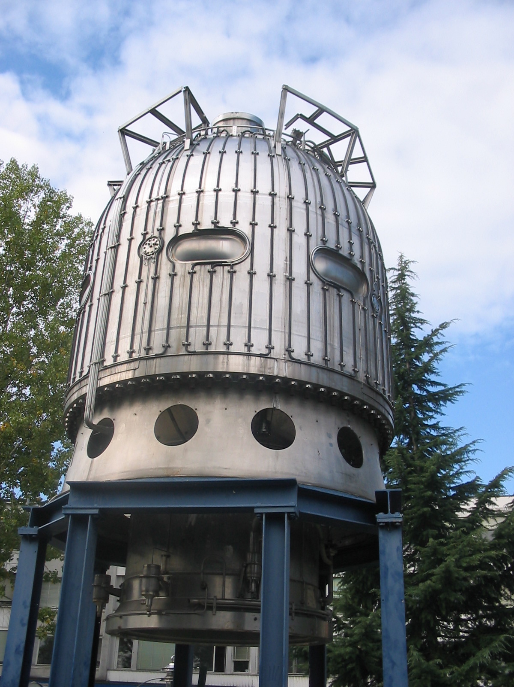
High Energy Physics before Electronics...
Bubble Chambers: ~1950
Photographic readout
  Extremely slow and inconvenient
  Accuracy limitations due to the chamber size

Slide 5
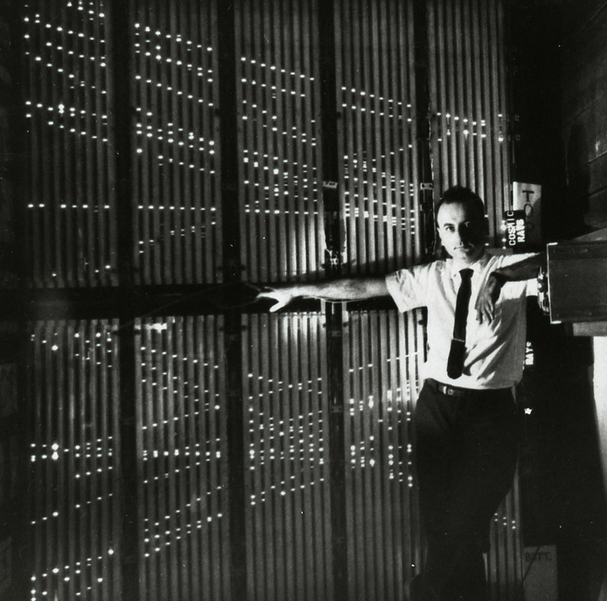
HEP before downscaled CMOS...
Spark/Wire Chambers: ~1960
Automatic (analog) readout is possible
  It is still very slow
  Low spatial resolution
  Low complexity

Slide 6
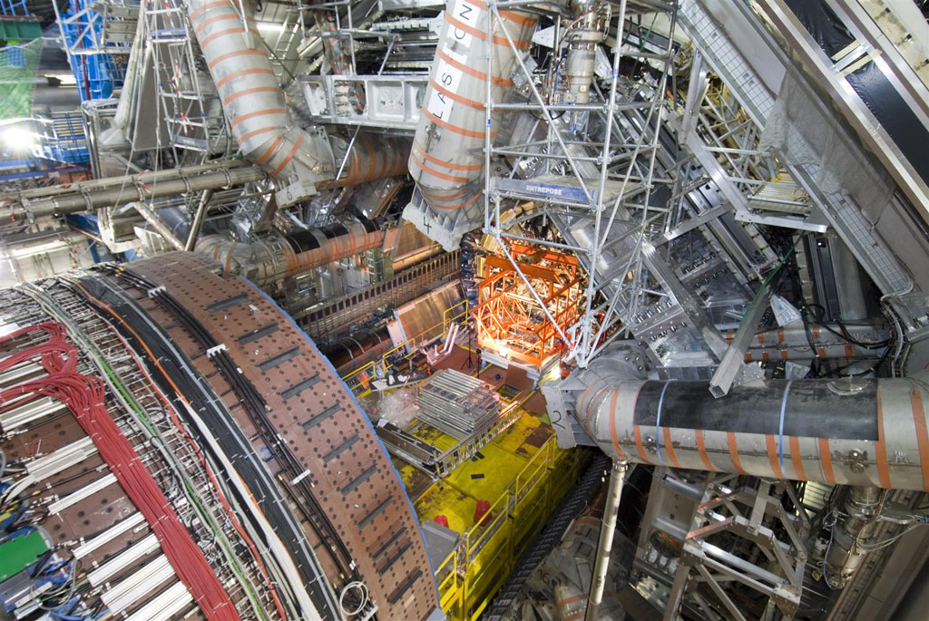
High Energy Physics now
(Mostly) silicon detecotrs

Slide 7
What does a “smart” detector allows?
Having the possibility to “put more stuff” in our detectors leads to many benefits
MUCH better performances!
  Spatial and time resolution
  Hit rate and efficiency
On-chip data analysis
Automatic triggering
Fully automated track reconstruction
“Learning” structures (self-correcting, self-calibrating detectors)

Slide 8
Outline
The role of CMOS technology in High Energy Physics
The push for a more downscaled technology
Applications to modern experiments
New developments and challenges
A design case: CLICpix and CLICpix2
Other projects
Conclusions

Slide 9
The need for a new technology
A more downscaled technology can help achieving the needs for future developments in imaging and high energy physics
Higher pixel density
Lower power consumption
Allows for faster and more complex designs
Better suited for “intelligent” pixels
Potentially better radiation hardness (?)
Drawbacks include:
Higher costs
More complex development
Notes:
How presentation will benefit audience: Adult learners are more interested in a subject if they know how or why it is important to them.
Presenter’s level of expertise in the subject: Briefly state your credentials in this area, or explain why participants should listen to you.

Slide 10
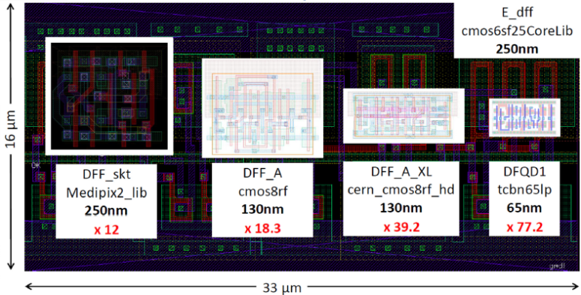
Why 65 nm?
Mature technology:
  Available since ~2007
High density and low power
Long term availability
(Relatively) affordable (MPW availability, but ~1 M$ NRE for final chips!)
Significantly increased density, speed and complexity
Still a known process, no high-K/metal-gate

Slide 11
“Moore’s law” for pixel detectors
CLICpix (2013) – 65 nm
Timepix3 (2013)
Transistor density per pixel area [transistors/µm²]
Medipix3RX (2012)
Medipix2 (2002)
FEI4 (2011)
FEI3 (2003)
Medipix1 (1998)
PSI46 (2005)
Rad-Hard designs
CMOS process [µm]

Slide 12
Risks and issues to address
Deep submicron technologies are not designed primarily for analog designs.
  Lower power supply voltage → lower dynamic range
  Process spread and device mismatch is worse for smaller devices
Higher density means more prominent “big chip effects”
More complex design rules and guidelines for design for manufacturing
More features and complexity leads to increased development time and harder verification

Slide 13
Outline
The role of CMOS technology in High Energy Physics
The push for a more downscaled technology
Applications to modern experiments
New developments and challenges
A design case: CLICpix and CLICpix2
Other projects
Conclusions

Slide 14
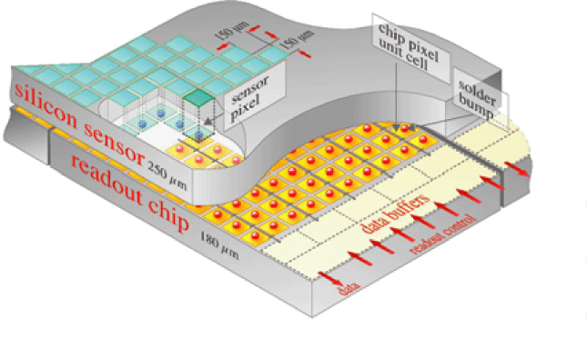
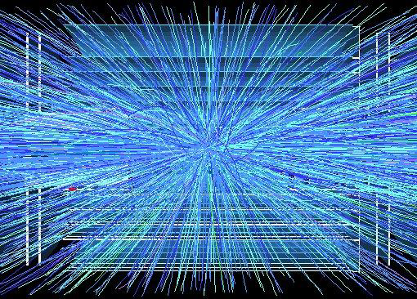
HL-LHC
ATLAS and CMS phase 2 pixel upgrades require advanced vertex detectors:
Very high particle rates: 500MHz/cm²
Smaller pixels: ~1/6 (~50x50µm²)
Increased readout rates: 100kHz -> ~1MHz
Low mass -> Low power
Unprecedented hostile radiation: 1 Grad, 10¹⁶ Neu/cm² → 10x increase!
Complex, high rate and radiation hard pixel chips

Slide 15
RD53: ATLAS-CMS-CLIC collaboration
RD53 is a collaboration between ATLAS, CMS and CLIC to set the ground to develop next generation of pixel readout chips
RD53 was organized to tackle the extreme and diverse challenges associated with the design of pixel readout chips for the innermost layers of particle trackers at future high energy physics experiments (LHC – phase II upgrade of ATLAS and CMS, CLIC)
19 Institutes
  Bari, Bergamo-Pavia, Bonn, CERN, CPPM, Fermilab, LBNL, LPNHE Paris, Milano, NIKHEF, New Mexico, Padova, Perugia, Pisa, Prague IP/FNSPE-CTU, PSI, RAL, Torino, UC Santa Cruz.
~100 collaborators

Slide 16
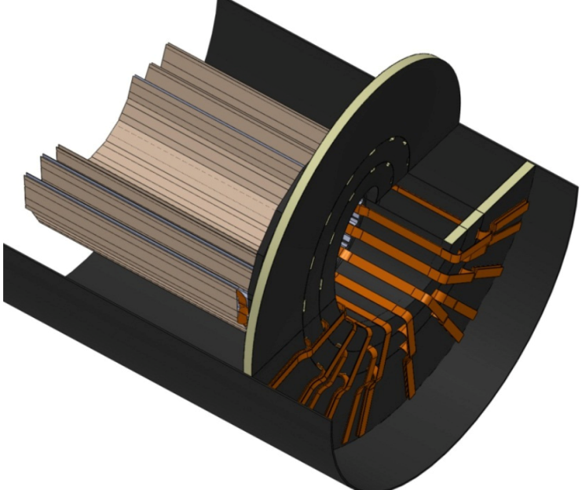
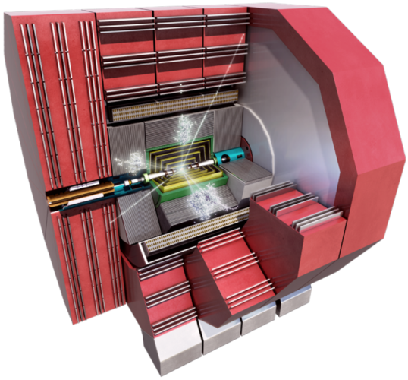
The CLIC detector
Vertex detector layers
< 6cm
The Compact Linear Collider (CLIC) is a study for a high-energy and high-luminosity collider
e⁺e⁻ collider
Can be used to determine standard model parameters with a higher precision than proton colliders
Bunch crossings every 0.5 ns in trains of 156 ns
Bunch trains every 20 ms → small duty cycle
Air cooling → low power consumption
Its vertex detector needs high spatial accuracy (~3 μm) → small pixels!

Slide 17
Outline
The role of CMOS technology in High Energy Physics
The push for a more downscaled technology
Applications to modern experiments
New developments and challenges
A design case: CLICpix and CLICpix2
Other projects
Conclusions

Slide 18
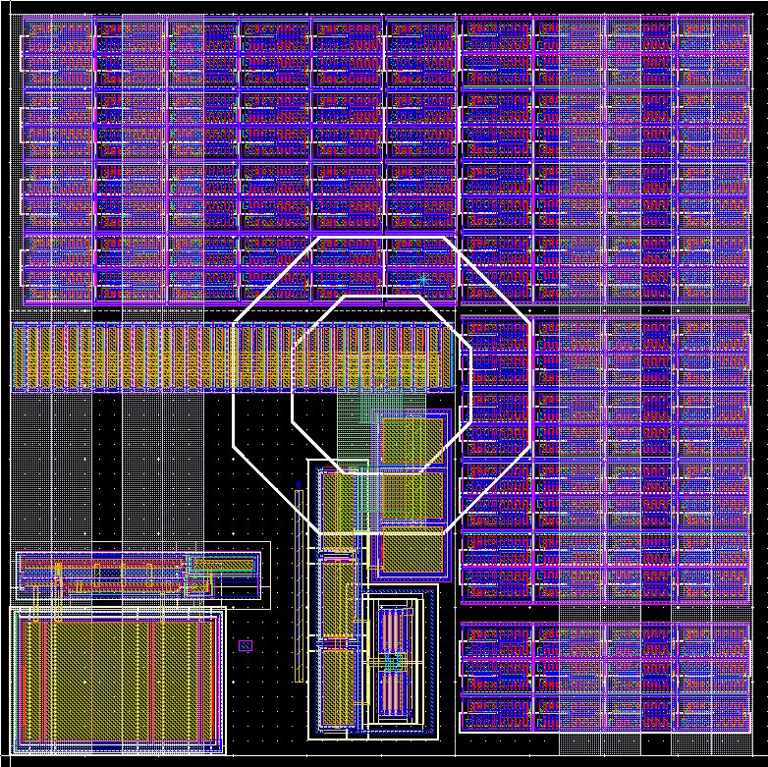
Analog/Digital integration
Abder Mekkaoui, RD53
A correct layout is crucial to avoid digital interferences in the low-noise analog front-end
Just as for digital columns, digital cores can be subdivided into regions for hit and latency memory sharing.
Physical layout must be optimized for bandwidth, clock distribution and other constraints
VDDA
GNDA
GNDD
VDDD
Quiet configuration logic
Quiet configuration logic
18

Slide 19
System architecture options
New interconnection solutions, such as TSVs
Larger modules with intra-layer intelligence (MPA, more about it later)

Slide 20
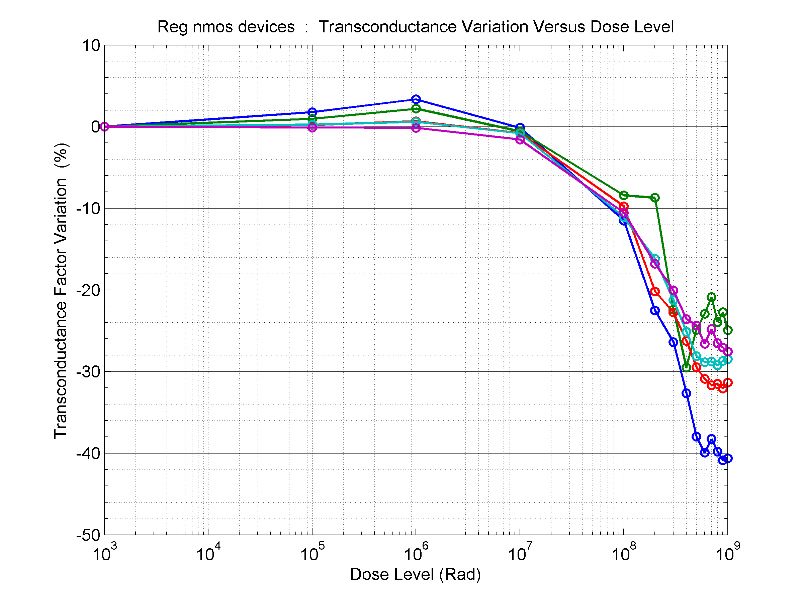
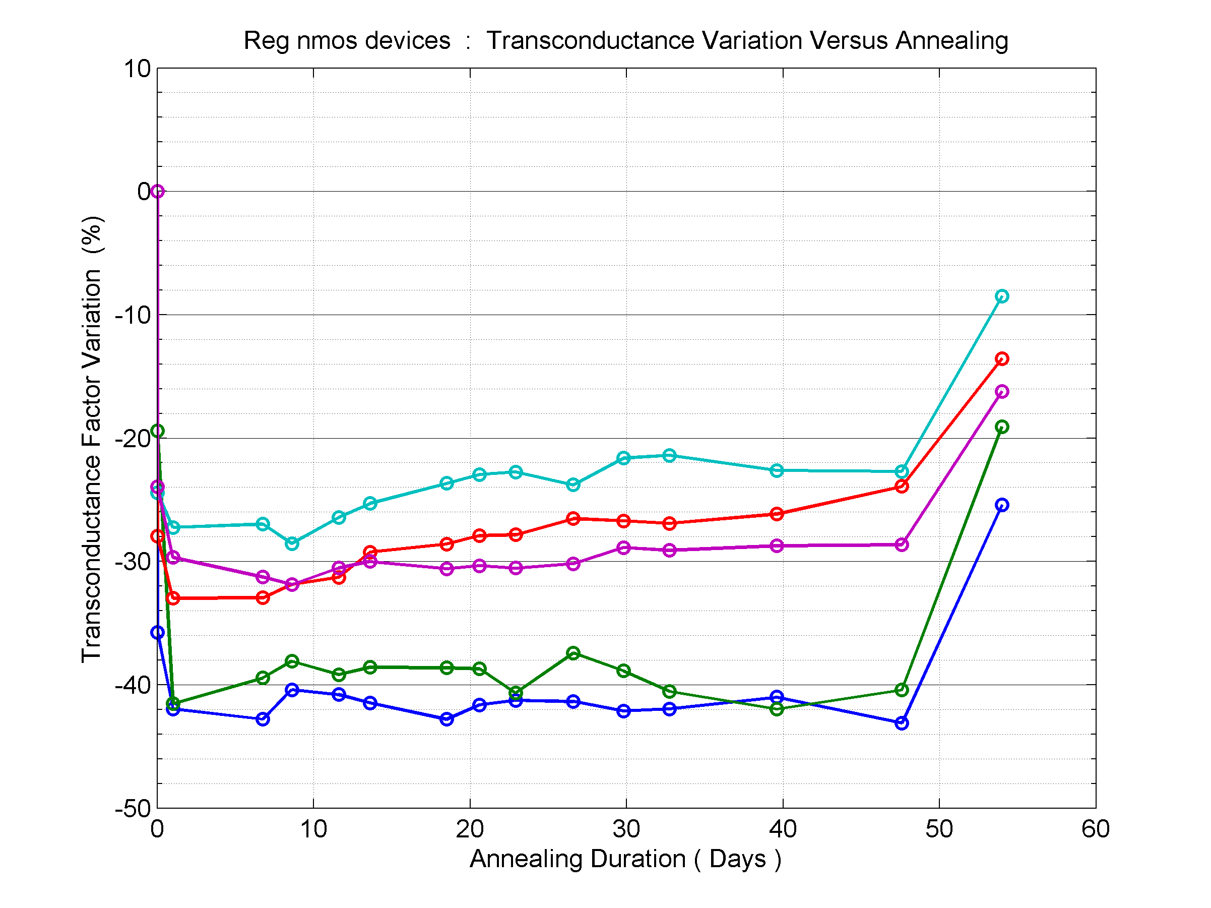
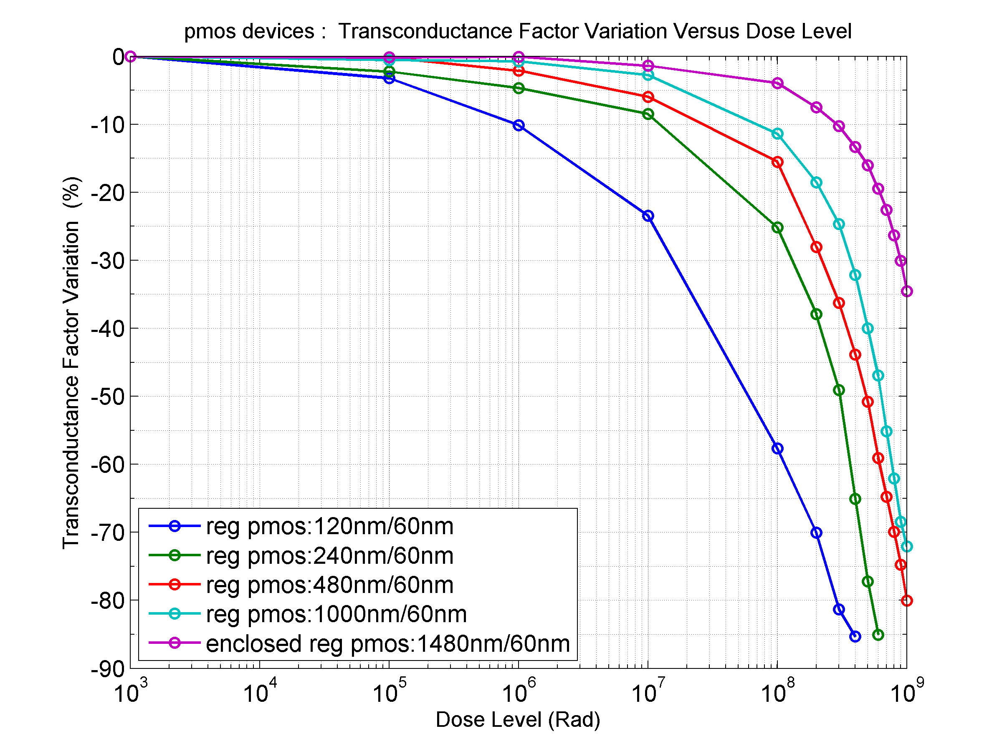
TID radiation effects: NMOS devices
-25C
25C
100C
After 1000 Mrad : transconductance loss is between 20% and 40%
The loss is still higher for narrower devices

Slide 21
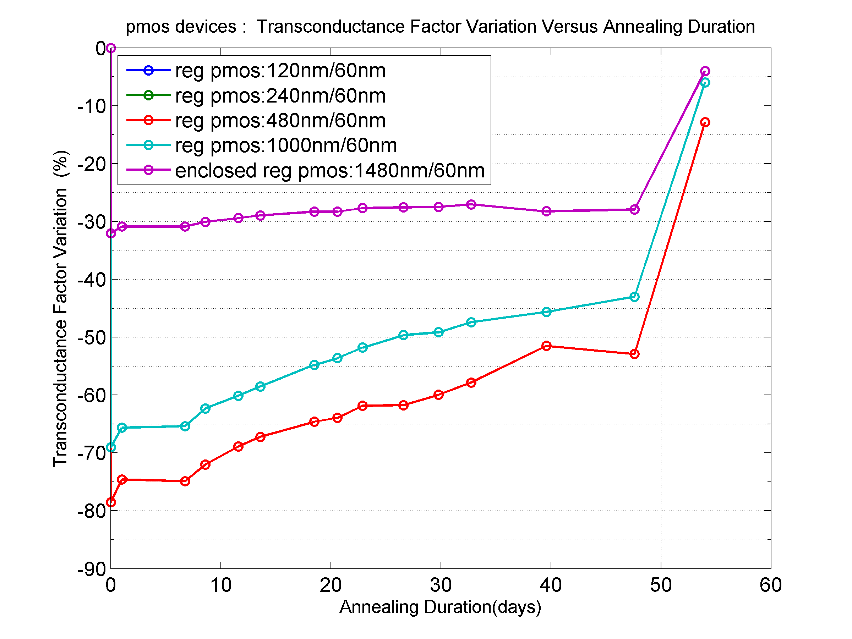
TID radiation effects: PMOS devices
-25C
25C
100C
For high level of dose (1000 Mrad), transconductance decrease reaches 100% for 120 nm and 240nm devices

Slide 22
Outline
The role of CMOS technology in High Energy Physics
The push for a more downscaled technology
Applications to modern experiments
New developments and challenges
A design case: CLICpix and CLICpix2
Other projects
Conclusions

Slide 23
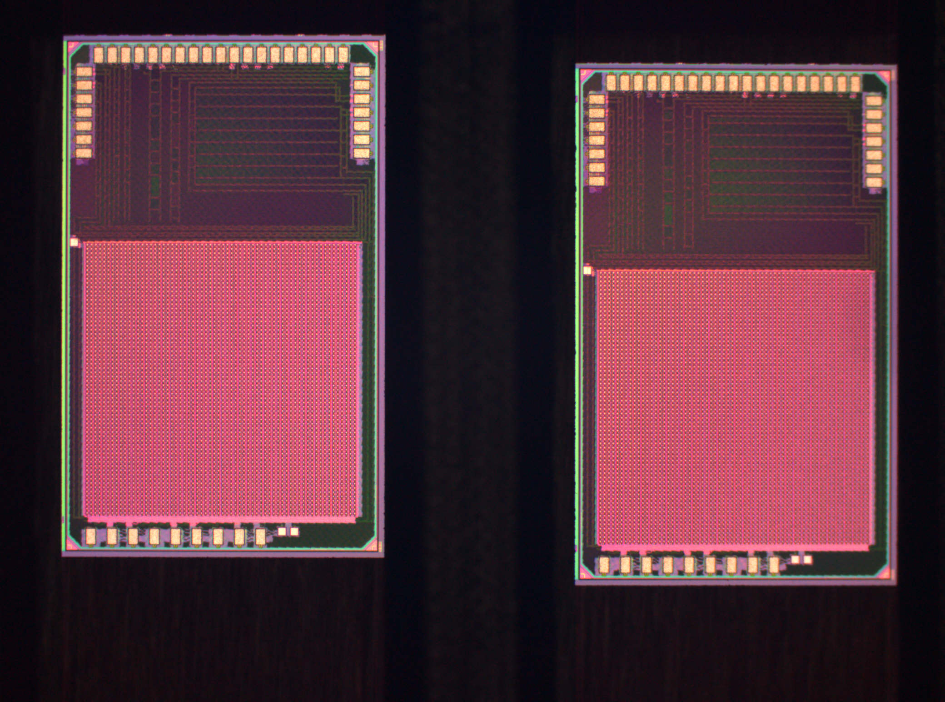
CLICpix
CLICpix is a hybrid pixel detector to be used as the CLIC vertex detector
Main features:
  small pixel pitch (25 μm),
  Simultaneous TOA and TOT measurements
  Power pulsing
  Data compression
A demonstrator of the CLICpix architecture with an array of 64x64 pixels has been submitted and tested
3 mm
1.85 mm

Slide 24
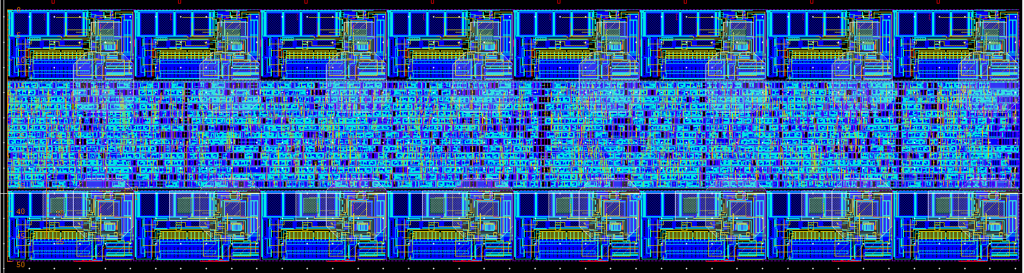
A simple block diagram
64x2 pixels double column
64x2 pixels double column
64x2 pixels double column
Analog part of adjacent pixels share biasing lines. Digital part is shared between each two adjacent pixels
200 μm
50 μm
64x64 pixel matrix
Chip periphery
32 End-of-Column blocks
Data OUT
Data IN
Biasing DACs
Compression logic
Power pulsing logic
Command interpreter

Slide 25
Pixel architecture
Top pixel
Clock
Feedback network
4-bit TOT counter
TOT ASM
Clk divider
Input
CSA
TOA ASM
4-bit TOA counter
Threshold
Polarity
Configuration data:
Th.Adj, TpulseEnable, CountingMode, Mask
V_{test_pulse}
4-bit Th.Adj DAC
HF
Bottom pixel
The analog front-end shapes photocurrent pulses and compares them to a fixed (configurable) threshold
Digital circuits simultaneously measure Time-over-Threshold and Time-of-Arrival of events and allow zero-compressed readout

Slide 26
Super-Pixel
In ClicPix, pixel clustering in 2x8 arrays allows to further compress the data for low occupancies (more in a few slides)
It also reduces the area because some of the electronics can be shared (clock distribution tree, biasing lines)
HF
Pixel Hit Flags

Slide 27
Clock distribution tree
The clock is distributed along each column exploiting the delays of buffers to give each pixel a clock signal with a different phase, in order to simplify the clock distribution tree and to avoid a synchronous switch of every pixel in the matrix (which would affect the stability of the power supply). The readout was simulated with a 320MHz clock
Periphery
(synchronous clock tree)

Slide 28
Pixel logic summary
Technology | 65 nm (High-Vt Standard Cells), Asynchronous State Machines
Pixel size | 25x25 µm 25x14 µm (Analog) 25x11 µm (Digital)
Acquired Data | TOT and TOA
Counter Depth (LFSR) | 4 bits TOT + 4 bits TOA (or counting, for calibration)
Target Clock Speed | 100 MHz (acquisition) 320 MHz (readout)
Data type | Full Frame Zero compression (pixel, super-pixel and column skipping)
Acquisition Type | Non-continuous
Power Saving | Clock gating (digital part), Power gating (analog part)

Slide 29
Readout Algorithm
Every column is read serially, sending the undivided clock to one column at a time
This solution works, but it is not very scalable for high clock speeds
29

Slide 30
Compression logic
Each pixel has an additional data bit used as a “flag”. It is implemented as a set Flip-Flop which is set to 1 as soon as either the ToA or the ToT registers start counting
The value of this bit is latched before the readout and it is used to control a MUX that allows readout of pixels to be skipped if they don’t contain valid data
The flags of all the pixels in a superpixel are used to generate a “superpixel flag”. This signal controls a MUX that allows entire superpixels to be skipped during readout
  The same is done with entire columns

Slide 31
Readout Architecture Comparison
  Randomly distributed hits
  400 x 400 pixels (1 cm2)
  8 bits/pixel
  Packet-based readout (red line), zero-compression with pixel, superpixel and column skipping (blue line)

Slide 32
Power pulsing
The specific application of the chip requires a very little duty cycle (the chip will acquire data for 156 ns every 20 ms), leaving the possibility to periodically turn off and on parts of the chip
The main contribution to the power consumption is the analog front-end, which would use ~2W/cm² if run continuously.
A power pulsing scheme has been implemented allowing to reduce the average power consumption to less than 50 mW/cm² (allowing the use of air cooling)
Power pulsing is activated by an external signal and it switches the biasing of the structures which use the most power to a low-power state. During this power saving state the analog power can be switched off entirely

Slide 33
Measurement summary
 | Simulations | Measurement
TOA Accuracy | < 10 ns | < 10 ns
Gain | 44 mV/ke⁻ | 40 mV/ke⁻
Dynamic Range | up to 40 ke⁻ (configurable) | up to 40 ke⁻ (configurable)
Non-Linearity (TOT) | < 8% at 40 ke⁻ | < 4% at 40 ke⁻
Equivalent Noise (no sensor capacitance) | ~60 e⁻ | ~51 e⁻ (with 10% variation r.m.s.)
DC Spread (uncalibrated) | σ = 160 e⁻ | σ = 128 e⁻
DC Spread (calibrated) | σ = 24 e⁻ | σ = 22 e⁻
Analog pixel power consumption (while ON) | 6.5 μW | 7 μW
Measurements expressed in electrons depend on capacitance values. A nominal value of 10 fF was assumed here for the test capacitor

Slide 34
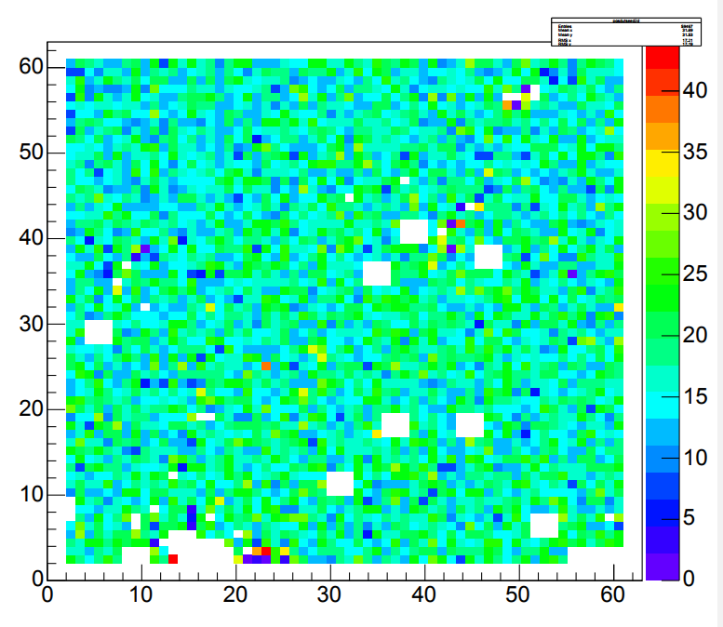
Some results with different sensors
CLIC Work in Progress
Row
The chip was tested with capacitively coupled HV-CMOS active sensors (designed by I. Peric) and with planar silicon sensors
The chip works correctly with both types of sensors and with both polarities
Some Fixed Pattern Noise can be seen: odd columns behave differently than even columns
Not having access to full wafers, the bump bonding process was particularly difficult; results are still good
#hits
Column
CLIC Work in Progress
Row
#hits
Column

Slide 35
Radiation Testing
The chip was irradiated up to 800 Mrads.
Above 200Mrad, the chip gradually turned off, as damaged switches used for biasing structures are unable to let the nominal current pass (their driving current becomes too low).
All I/O interfaces and digital structures did not show any significant degradation during irradiation, even after the analog front-end stopped working
The chips regained some functionality after two week of annealing at room temperature (the total power consumption went back to pre-rad value). Analog performances of the measured chip were found to be considerably degraded.

Slide 36
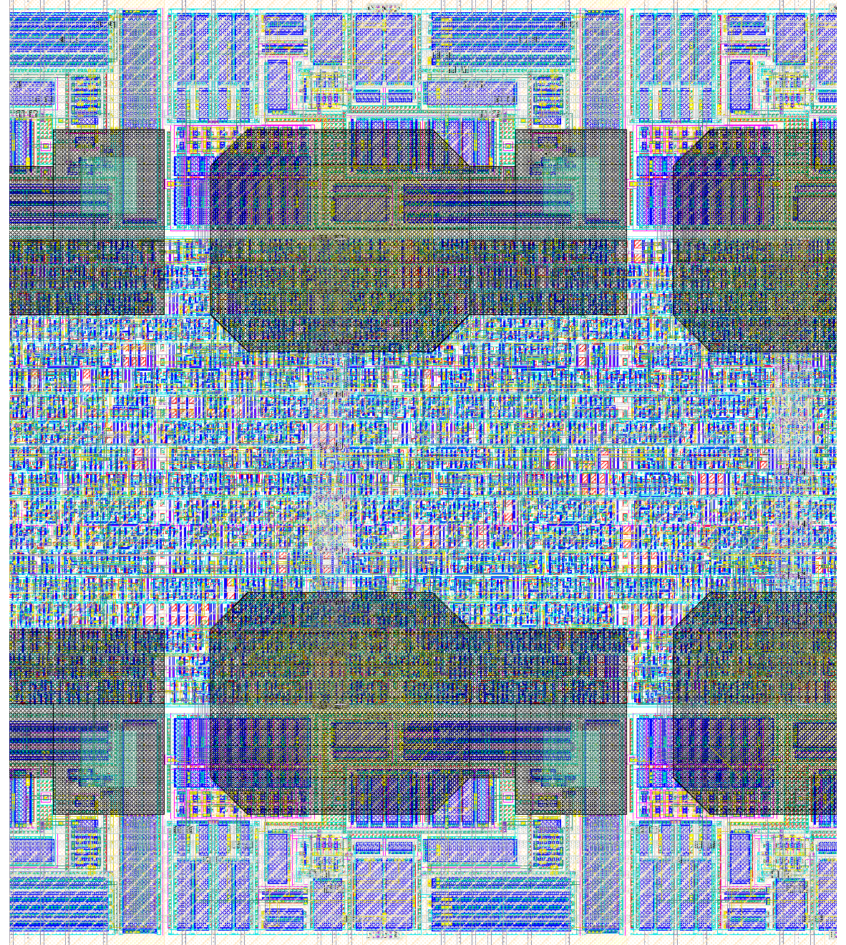
Challenges in integration
Analog Part
Digital Part
While logic circuits scale with the technology, the interconnects don’t follow the same trend!
Space used by bonding pads and power routing becomes a limiting factor
  CLICpix can’t possibly be larger than ~350 by 350 pixels with this a “classic” power distribution scheme
TSVs could be used to limit this problem and allow more flexible designs
Analog Part

Slide 37
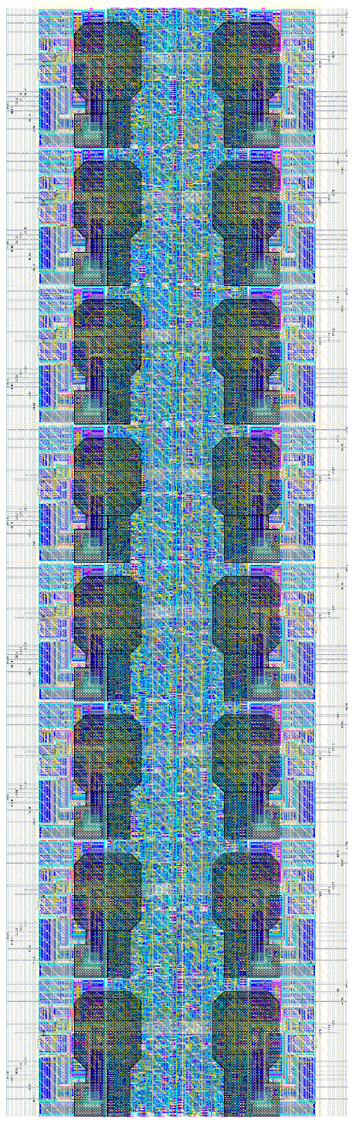
Many advantages
Incredibly dense layouts are possible, with many advanced features in a small area
  ToT/ToA/photon counting, on-the-fly data compression in a quarter of the size of a Medipix3 pixel
For structures of the same size, a more downscaled technology leads to better matching
Faster readout links, lower pileup in the pixels
Potential for more complex logic (e.g. automatic calibration, on-chip data processing)
Digital Part

Slide 38
Noise and crosstalk issues
More compact layouts, faster and bigger logic circuits, pose a concern on noise performances
Limited space for shielding or trenches
Solutions include better substrate isolation (deep n-well), but also more careful placement and routing of digital cells
Large scale signal integrity issues must be carefully evaluated
These issues were found to be very relevant when characterizing CLICpix!

Slide 39
Lessons learned
Feasibility of high density pixel chips with advanced features using 65 nm technology has been proved
Design flow using new software tools was established, simulation models have been validated
The main challenges include analog/digital integration and design of high performances analog structures

Slide 40
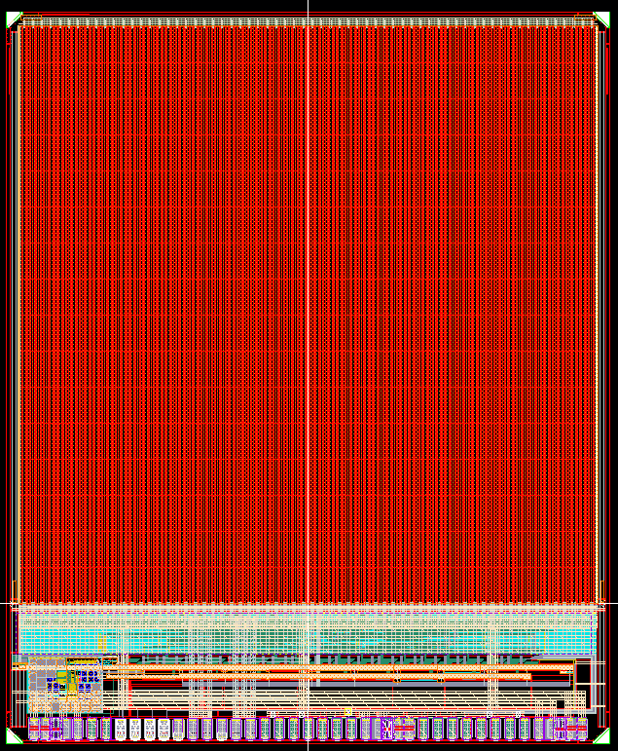
ClicPix2
3.3 mm
CLICpix had some issues that warranted a redesign
  A crosstalk coupling to the input pad limits the minimum threshold
  A small readout bug limits the performance of the data compression
Since we were going for an updated design, other improvements could be made:
  Bigger pixel matrix (128 by 128)
  Longer counters for ToT and ToA to make testing more efficient
  Implement a smarter I/O protocol to allow an easier system design and a faster readout
  Better noise isolation
  More testing features
4 mm

Slide 41
Additional Digital Features
In the pixels:
  5 bits ToT (up from 4)
  8 bits ToA (up from 4)
  Optional 13 bits ToA instead of ToT (it can be used as event counter too)
Easier to decode and more robust data format
Faster readout with more standard protocol
Automatic test pulse generator
I/O link testing routine
Some debug features

Slide 42
Improvements in the analog pixel
Pixels have a smaller, more optimized analog part to leave space for more digital features
Layout is mirrored, to improve pixel-to-pixel uniformity
Some blocks in the periphery which were missing in the previous chip were added, including:
  A Bandgap reference, which makes the chip more robust to temperature changes
  Temperature sensor
  Power supply test-point
  An electrical connection for the grounding of sensor guard-rings

Slide 43
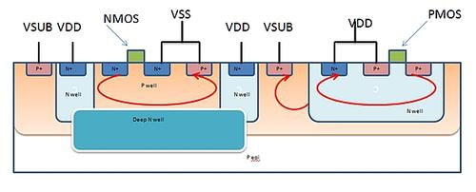
Noise Isolation
All the analog structures have now a deep n-well isolation structure, to physically separate their substrate from the noisy digital blocks
The analog pixel has a mirrored layout, making the connections to their corresponding logic shorter
More care has been put in shielding critical nodes
Power supply distribution has been optimized to reduce “bouncing”

Slide 44
Readout algorithm
In order to use clock recovery from data stream, which simplifies the readout system, we set a target bandwidth of 640 Mbit/s over a single (differential) serial link
If the chip worked as CLICpix, a 640 MHz clock would have to be sent to the pixels, which is very demanding and not scalable if we want to use an even faster clock
A more general solution is to allow reading out data from multiple columns at the same time using a slower clock and then serialize data at the output (using a DDR serializer)
At the same time, the clock is divided by the same ratio to match the output bandwidth
The system is entirely configurable: we can read 1/2/4/8 columns at a time and the clock divider can be configured independently (although not every combination was tested!)

Slide 45
Parallel Readout
If the chip is configured to read more than one column at a time, the matrix is divided in equal parts (by column), reading one column from each part
The data is then serialized with the readout clock
8/10 bit encoding is added at the output
45

Slide 46
Readout Time
Occupancy
Occupancy
Readout time (ms)
Readout time (ms)
# columns
# columns
Readout time with a 640 Mb/s serializer
Readout time with a 2 Gb/s serializer
The readout time is well within the CLIC specifications even with 2 parallel columns

Slide 47
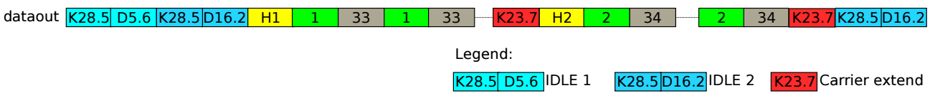
I/O protocol
The data stream is now properly divided into packets, each containing data from one or more double columns
The data packets follow the Ethernet physical specification
Headers dividing the packets contain relevant chip settings to allow for data reconstruction without any additional information
These modifications make the data format much more easily readable

Slide 48
Outline
The role of CMOS technology in High Energy Physics
The push for a more downscaled technology
Applications to modern experiments
New developments and challenges
A design case: CLICpix and CLICpix2
Other projects
Conclusions

Slide 49
Other 65 nm projects
MPA (Macro Pixel ASIC) - CERN
  Front-end to be used CMS tracker upgrades for HL-LHC
  100 x 1446 μm pixels
  Modules with local pT discrimination
LpGBT - CERN
  Low-power/small-footprint version of GPT chip
Gigabit transmitter for the BELLE-II pixel detector – University of Bonn

Slide 50
Outline
The role of CMOS technology in High Energy Physics
The push for a more downscaled technology
Applications to modern experiments
New developments and challenges
A design case: CLICpix and CLICpix2
Other projects
Conclusions

Slide 51
Conclusions and next steps
Design work has started in 65nm (FEs, IPs) and many projects are now using this technology as their baseline
  The technology has been validated and it can help face the challenges of a new generation of pixel detectors
  Functionality of this CMOS process has been proved in CLICpix and it will be studied further in a number of new chips being developed in the following months/years
Radiation performance is good, but it has to be studied for extremely high doses

Slide 52
Some food for thought…
Moving to a new downscaled technology is risky, but it’s also necessary to go beyond current limitations
New architectures have to be taken into consideration
  Some structures become less feasible with lower voltages
  What worked before is not necessarily the best option for the future
  More complex logic can lead to advantages on the analog side too!
What we consider “new” has actually been around for many years in other applications! The know-how to develop the next generation of pixel detectors is already available now.

Slide 53
Thanks for your attention

