Slide 1
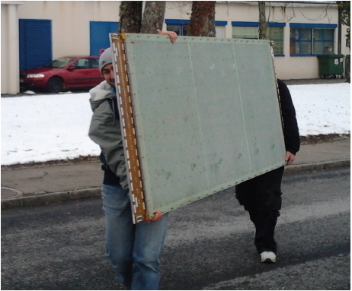
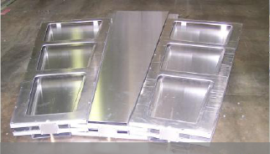

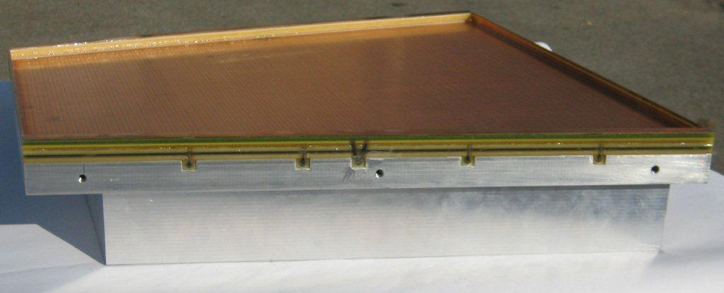
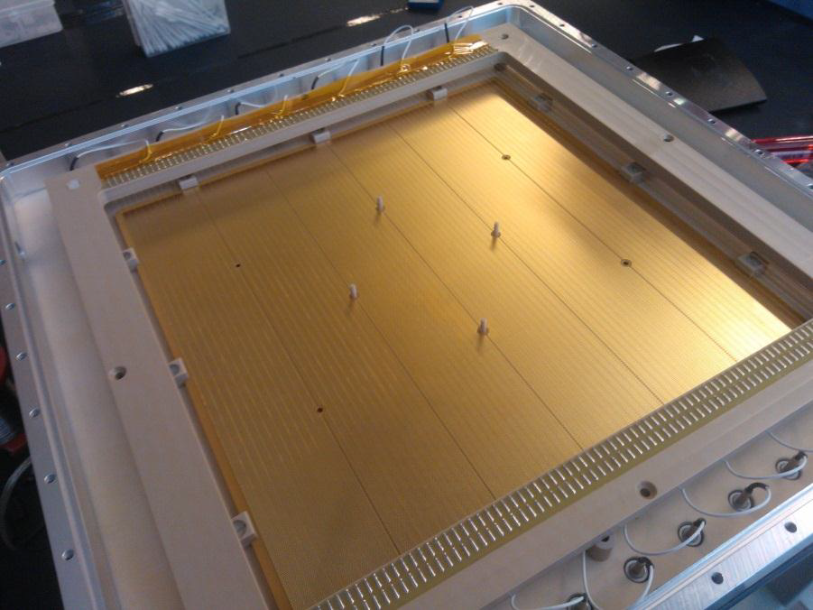
« Development of Micro-Pattern
Gaseous Detector Technologies »
and the RD51 Collaboration
MM for ATLAS upgrade
Maxim Titov, CEA Saclay, France
GEM for CMS upgrade
OUTLINE of the TALK:
Introduction: Major Micro-Pattern gas Detector Technologies
(GEM, Micromegas, Thick GEM, InGrid, mPIC)
Summary of the RD51 – MPGD Technology Highlights
(Large area MPGDs - Support of HL- HLC Upgrades, R&D (quality control, long-term tests), Academia-Industry Matching Event, Software & Simulation, SRS Electronics, CERN MPGD Production Facility & Industrialization, RD51 Test Beam Facility, Training)
GEM for ALICE TPC
upgrade
THGEM for COMPASS
upgrade
Joint Instrumentation Seminar, DESY/Hamburg, September 4, 2015

Slide 2
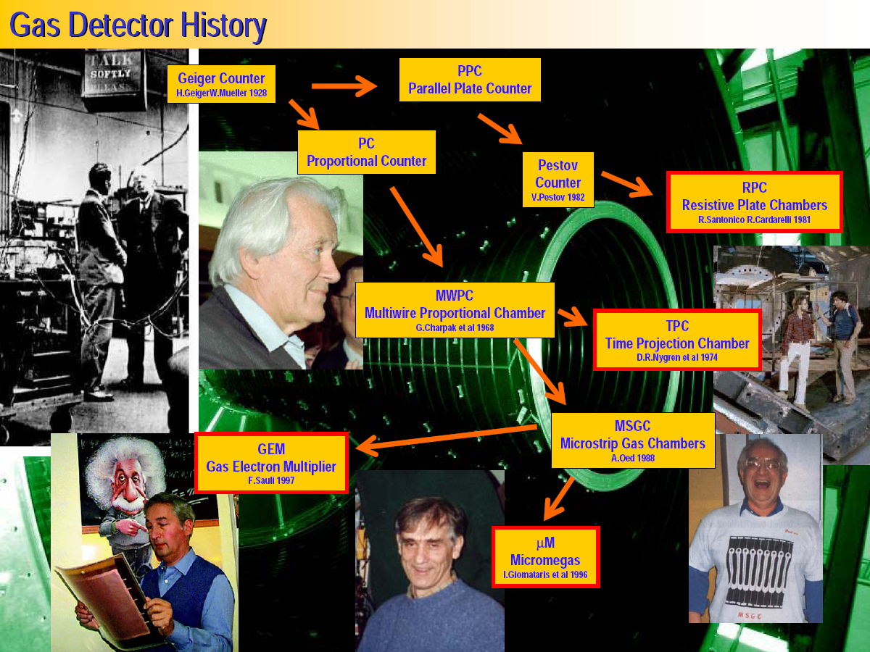
History of Gaseous Detector Developments
M. Hoch, 2004 Wire Chamber Conference

Slide 3
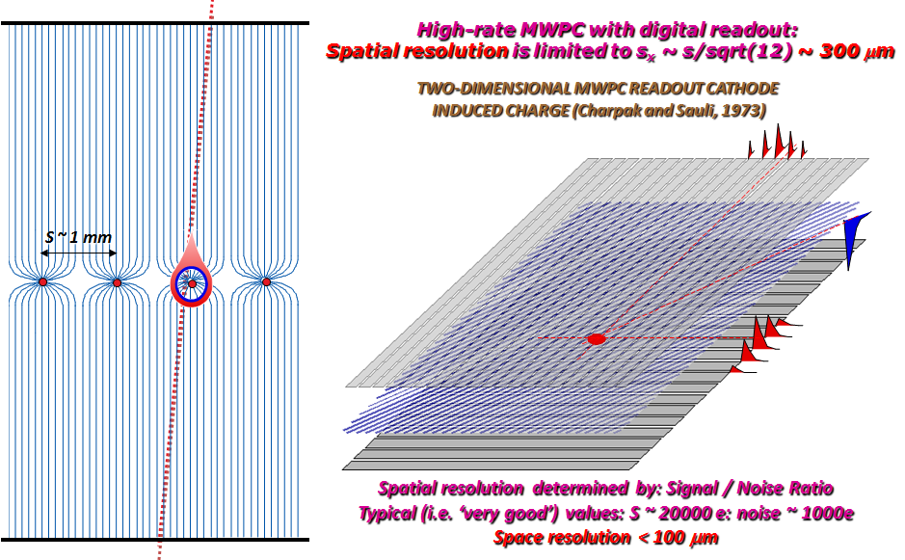
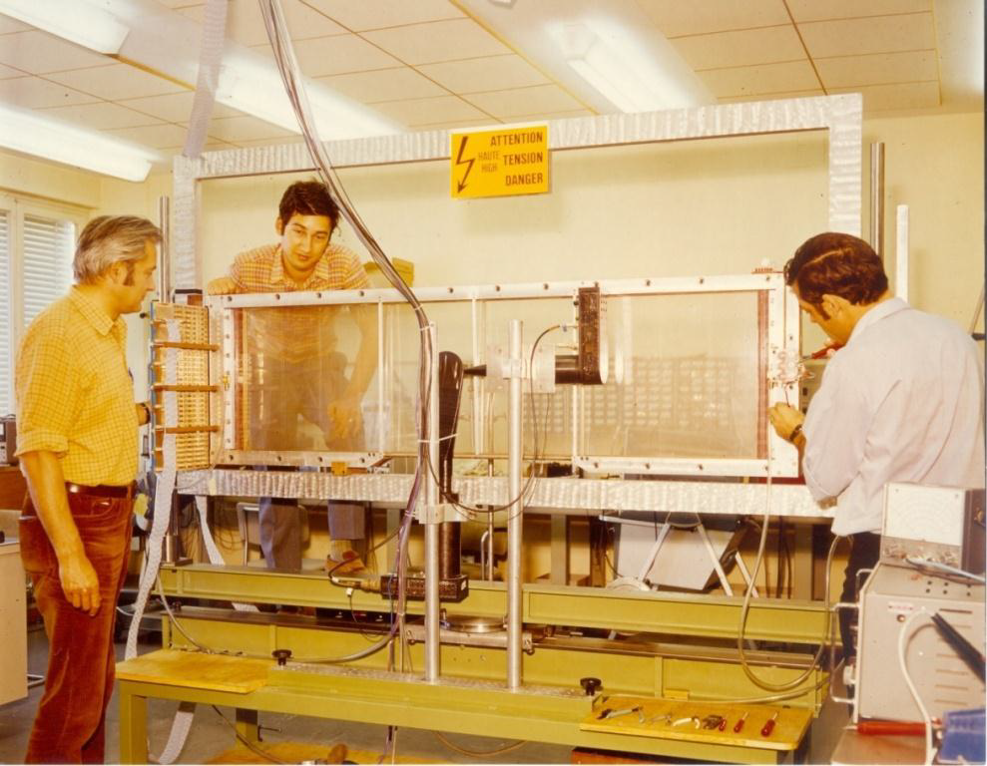


Multi-Wire Proportional Chamber (MWPC)
Gaseous proportional tracking detectors that revolutionized High Energy Physics
With Fabio Sauli et Jean Claude Santiard
The 1st “Large Wire Chamber”…
The invention revolutionized
particle detection, which
passed from the manual
to the electronic era.
Georges Charpak
1924 – 2010

Slide 4
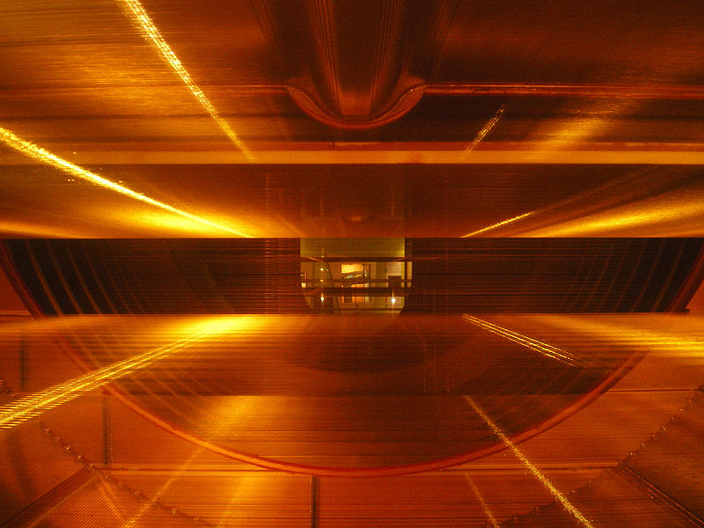
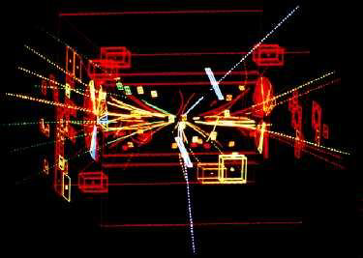
Nobel Prize: W, Z - Discovery at UA1/UA2 (1983)
UA1 used the largest imaging drift chamber of its day
(5.8 m long, 2.3 m in diameter)
It can now be seen in the CERN Microcosm Exhibition
Particle trajectories in the CERN-UA1
3D Wire Chamber
Discovery of W and Z bosons
C. Rubbia & S. Van der Meer
Nobel Prize 1984
Z → ee (white tracks)

Slide 5
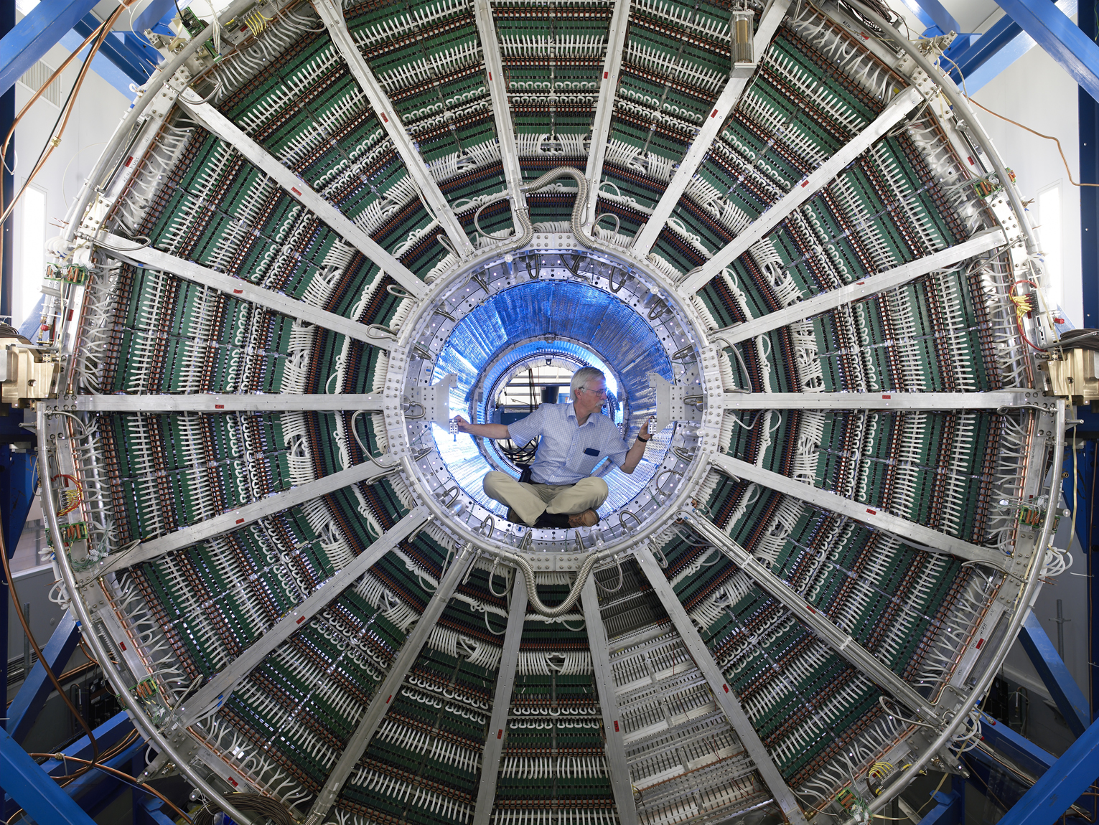
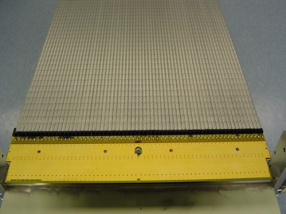
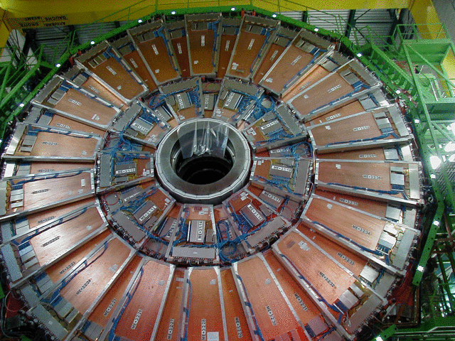
Gaseous Detectors in LHC Experiments
 | Vertex | Inner Tracker | PID/ photo- det. | EM CALO | HAD CALO | MUON Track | MUON Trigger
ATLAS | - | TRD (straws) | - | - | - | MDT (drift tubes), CSC | RPC, TGC (thin gap chambers)
CMS TOTEM | - | - | - | - | - | Drift tubes, CSC, GEM | RPC, CSC GEM
LHCb | - | Straw Tubes | - | - | - | MWPC | MWPC, GEM
ALICE | - | TPC (MWPC) | TOF(MRPC), PMD, HPMID (RICH-pad chamber), TRD (MWPC) | - | - | Muon pad chambers | RPC
ALICE TPC
Straw tubes
CMS CSC
Gaseous detectors are still the first choice whenever the large-area coverage (e.g. muon systems) with low material budget is required

Slide 6
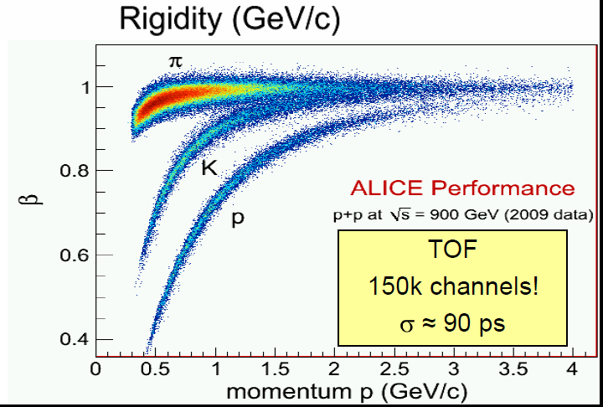

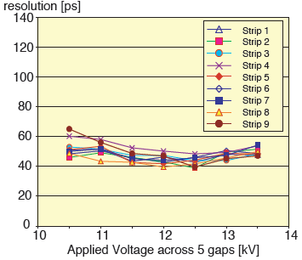

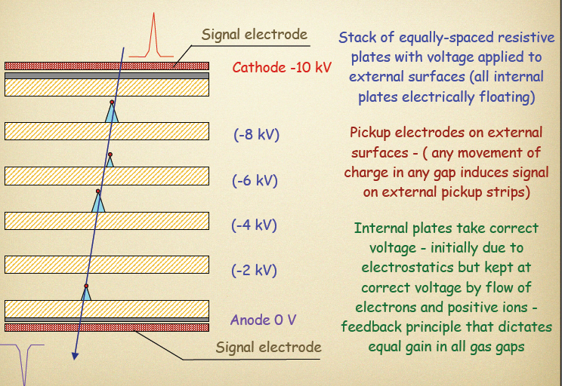
ALICE Multi-Gap RPC: Timing Resolution
Relevant scale in HEP: t ~ L(m)/c ~ o(ns)
Traditional technique:
  Scintillator + PMT ~ o (100 psec)
Breakthrough with a spark discharge in gas
  Pestov counter → ALICE MRPC ~ 50psec
Multi-Gap Resistive Plate Chamber: Basic Principle
Technology | Time resolution
Pestov Counter | 30-50 ps
RPC | ~ 1-5 ns (MIP)
MultiGap RPC | ~ 50 ps (MIP)
GEM | ~ 1-2 ns (UV) ~ 5 ns (MIP)
Micromegas | ~ 700 ps (UV) ~ 2-5 ns (MIP)
C. Williams, CERN Detector Seminar
“ALICE Time of Flight Detectors”:
http://indico.cern.ch/conference
Display.py?confId=149006

Slide 7
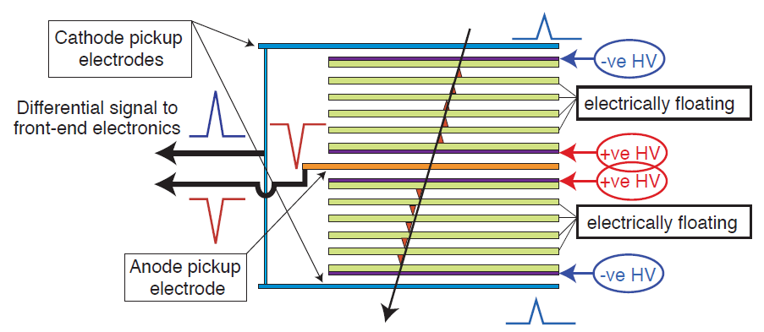
ALICE Multi-Gap RPC: Timing Resolution
Relevant scale in HEP: t ~ L(m)/c ~ o(ns)
Traditional technique:
  Scintillator + PMT ~ o (100 psec)
Breakthrough with a spark discharge in gas
  Pestov counter → ALICE MRPC ~ 50psec
ALICE-TOF has 10 gaps (two stacks of 5 gas gaps);
each gap is 250 micron wide
Technology | Time resolution
Pestov Counter | 30-50 ps
RPC | ~ 1-5 ns (MIP)
MultiGap RPC | < 50 ps (MIP)
GEM | < 1-2 ns (UV) ~ 5 ns (MIP)
Micromegas | < 700 ps (UV) ~ 2-5 ns (MIP)
C. Williams, CERN Detector Seminar
“ALICE Time of Flight Detectors”:
http://indico.cern.ch/conference
Display.py?confId=149006

Slide 8
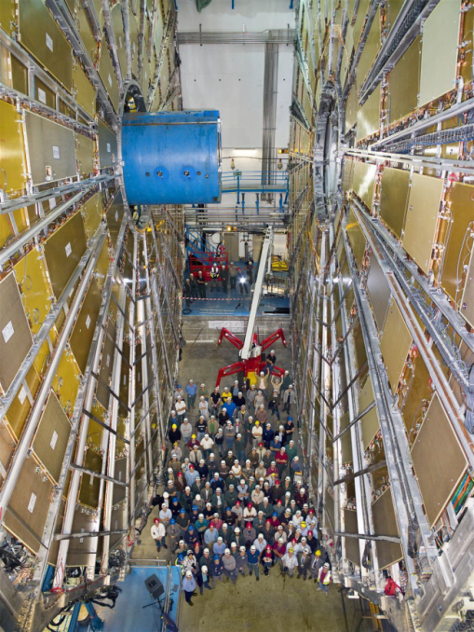
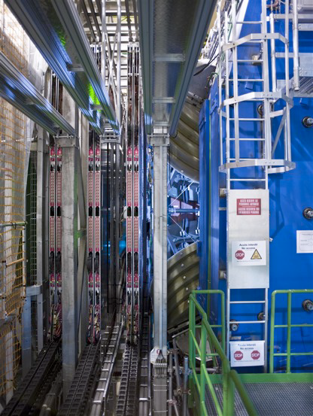
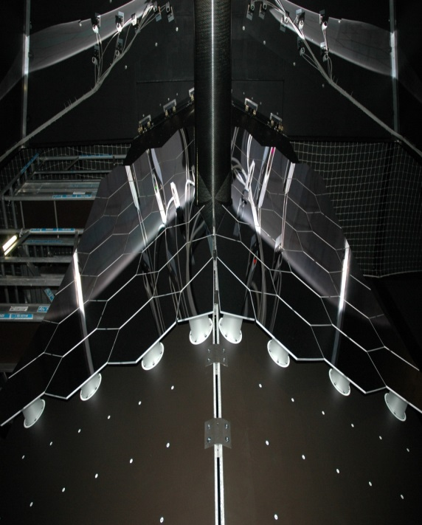
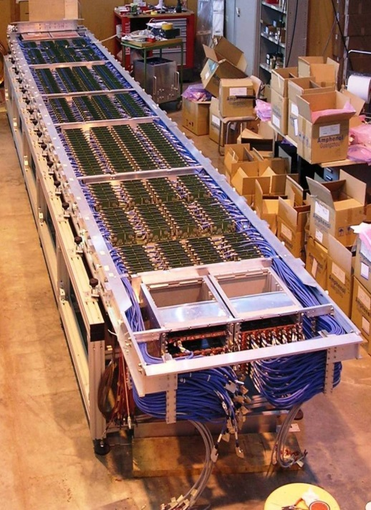
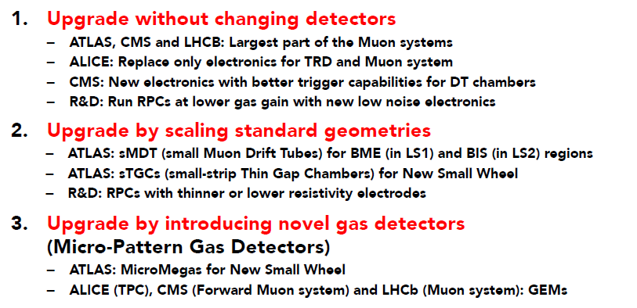
Gaseous Detector Systems for the High-Luminosity LHC
ATLAS TGC
LHCb Outer
Tracker
ALICE HPMID
ALICE MRPC
Upgrade Options for HL-LHC:

Slide 9
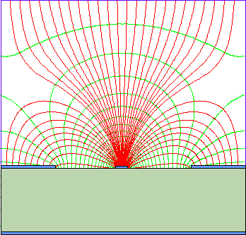
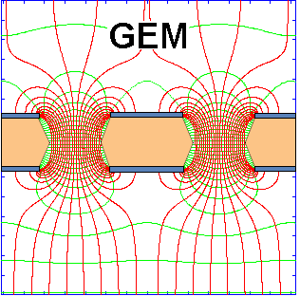
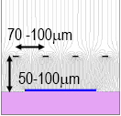
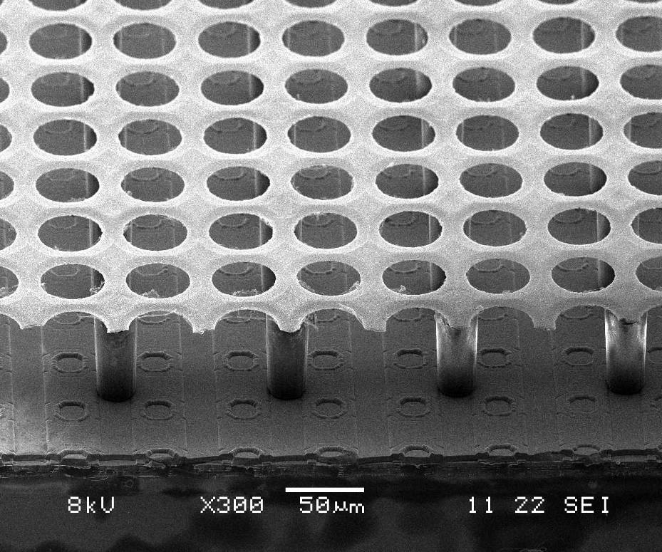
100 μm
INSTRUMENTATION FRONTIER:
DEVELOPMENT OF MICRO-PATTERN
GASEOUS DETECTOR TECHNOLOGIES
MSGC:
10 μm
High Rates & enormous occupancy:
Silicon detectors:
Si-strips →Pixel (2D)→ 3D detectors
& 3D TSV integration
Gaseous detectors:
Wire Chamber → Wireless MPGD (2D) → InGrid/Timepix (3D)
50 μm
140 μm
Micromegas:
Detector –Electronics Integration → Enabled by Advanced Technologies
(better granularity / high precision / small amount of material)
Modern photo-lithography technology → Micro-Pattern Gas Detectors
Microelectronics – eg. Silicon pixels
Bump bonding technology – low capacitance connections
Trade-offs between high-speed, power, S/N, integration, segmentation, radiation tolerance → defined by the state-of-the-art in microelectronics
Ingrid

Slide 10
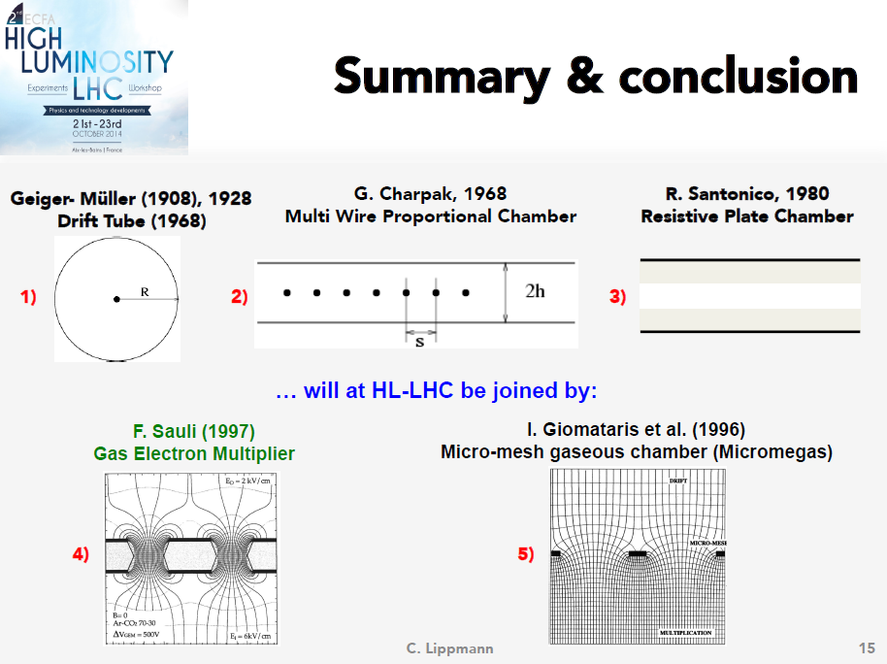
Christian Lippmann, 2nd ECFA High Luminosity LHC Experiments
Workshop, Aix-les-bains, France, October 21-23 (2014)

Slide 11
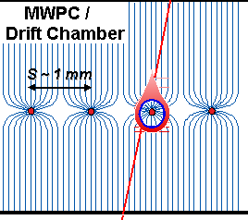
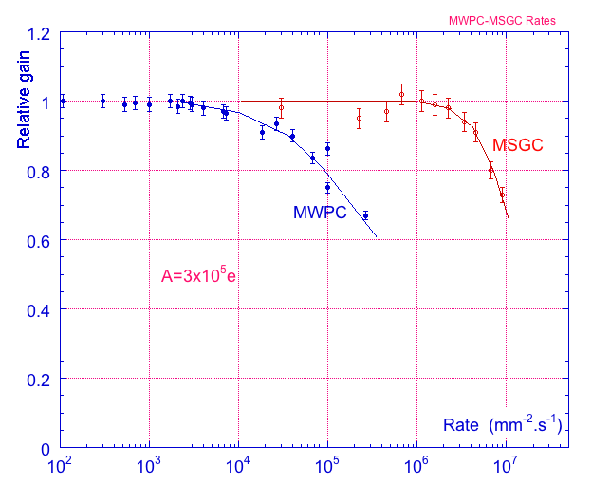
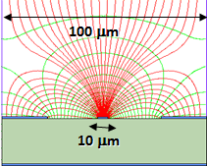
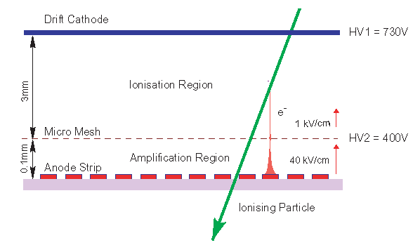
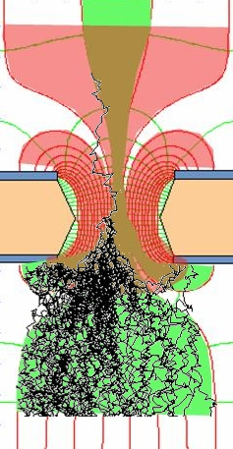
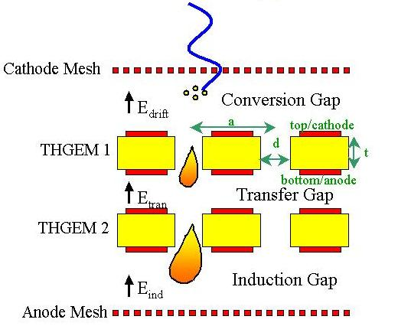
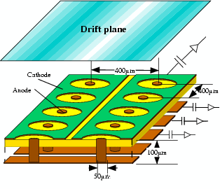
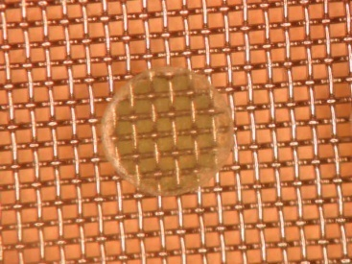

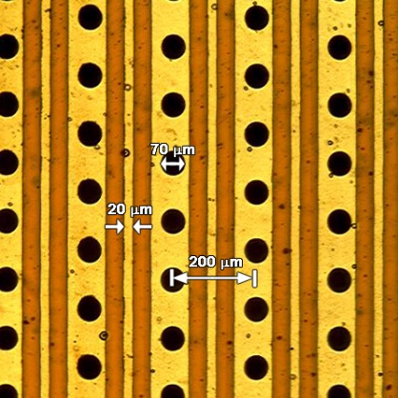
Micro-Pattern Gaseous Detector Technologies for Future Physics Projects
Micromegas
GEM
Thick-GEM, Hole-Type and RETGEM
MPDG with CMOS pixel ASICs (“InGrid”)
Micro-Pixel Chamber (μPIC)
Rate Capability:
MWPC vs MSGC
Micromegas
GEM
THGEM
MHSP
μPIC
Ions
40 %
60 %
Electrons
InGrid

Slide 12

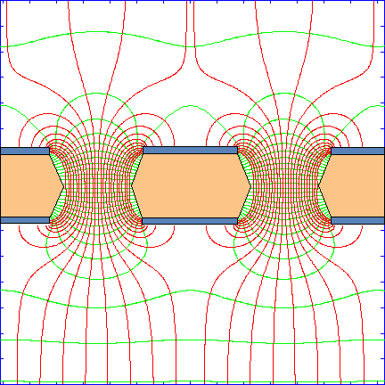
GEM (Gas Electron Multiplier)
Thin metal-coated polymer foil chemically pierced by a high density of holes
A difference of potentials of ~ 500V is
applied between the two GEM electrodes.
→the primary electrons released by the
ionizing particle, drift towards the holes
where the high electric field triggers the
electron multiplication process.
I⁺
e⁻
Induction gap
e⁻
S1
S2
S3
S4
Electrons are collected on patterned
readout board.
A fast signal can be detected on the lower
GEM electrode for triggering or energy
discrimination.
All readout electrodes are at ground potential.
F. Sauli, Nucl. Instrum. Methods A386(1997)531
F. Sauli, http://www.cern.ch/GDD

Slide 13
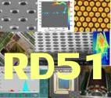
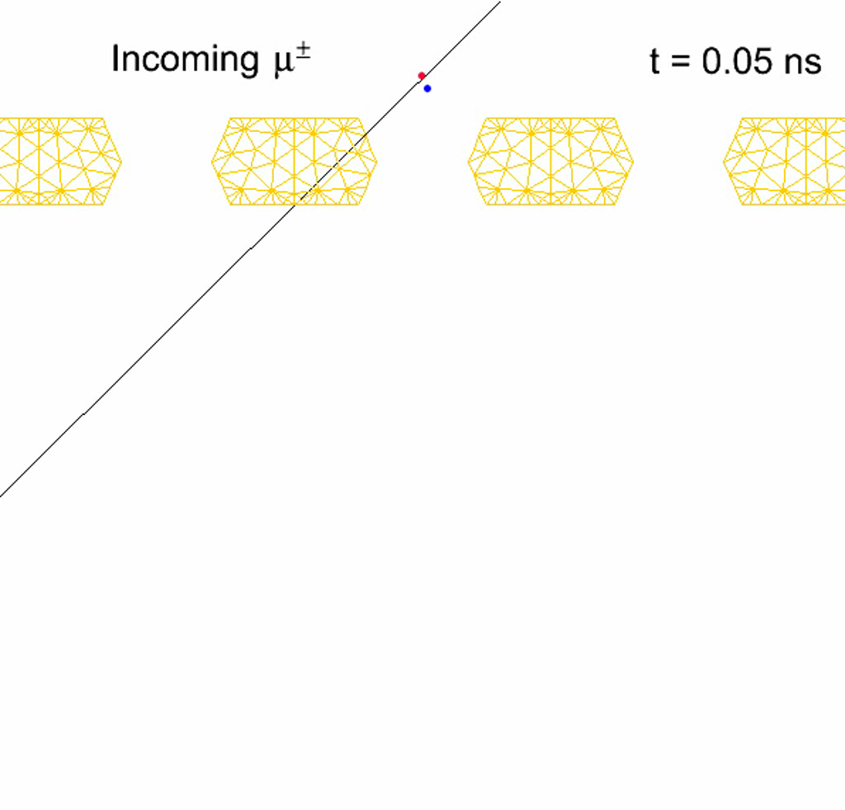
MPGD Simulation Tools (Avalanche Simulation in GEM)
Animation of the avalanche process
(monitor in ns-time electron/ion
drifting and multiplication in GEM):
electrons are blue, ions are red, the
GEM mesh is orange
ANSYS: field model
Magboltz 8.9.6: relevant
cross sections of electron-matter interactions
Garfeld++: simulate
electron avalanches
http://cern.ch/garfieldpp/examples/gemgain

Slide 14
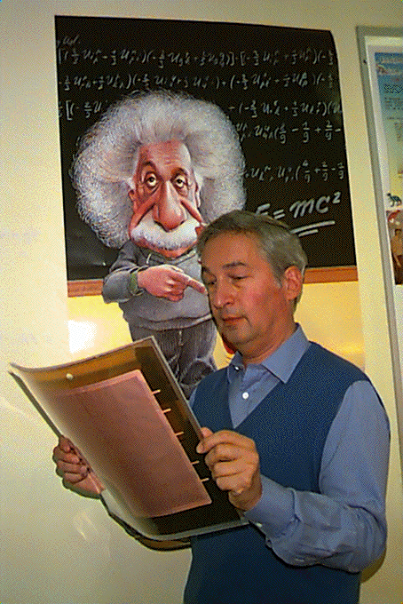
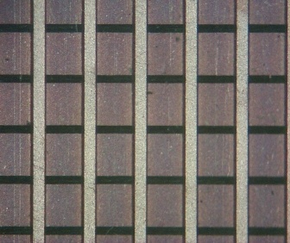
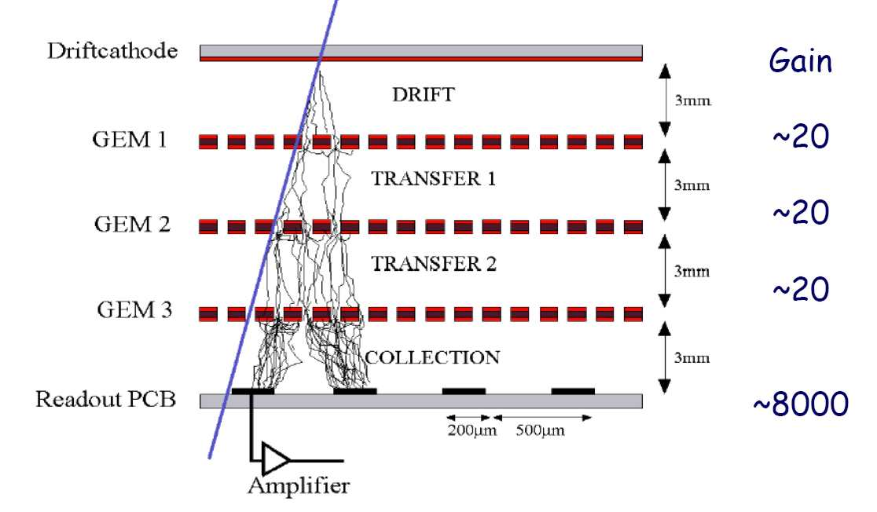
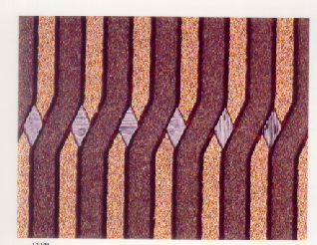
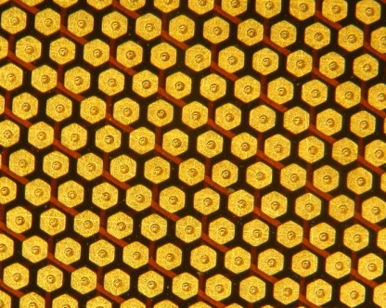
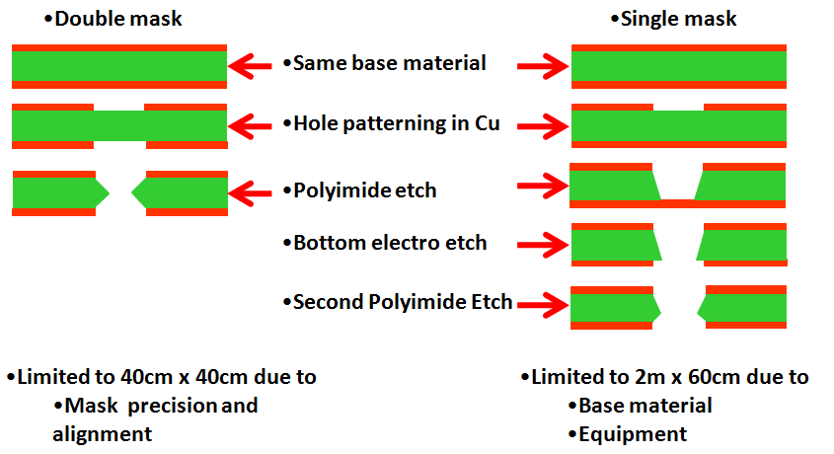
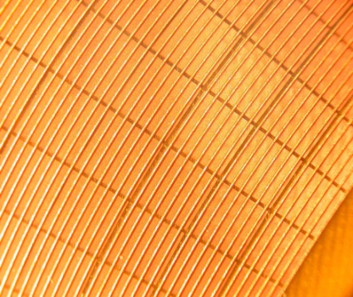
Gas Electron Multiplier (GEM)
F. Sauli, NIM A386(1997) 531;
F. Sauli, http://www.cern.ch/GDD
Full decoupling of amplification stage (GEM)
and readout stage (PCB, anode)
Cartesian
Compass, LHCb
2009: NEW: Single mask GEM production technique →
allow to extend GEM foils to ~ m² area
Small angle
Hexaboard, pads
MICE
1996:
2009:
Mixed
Totem

Slide 15
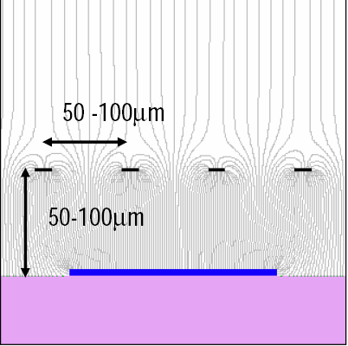
MICro MEsh GAseous Structure (MICROMEGAS)
Micromesh Gaseous Chamber:
micromesh supported
by 50-100 μm insulating pillars
Multiplication (up to 10⁵ or more)
takes place between the anode and
the mesh and the charge is collected
on the anode (one stage)
Small gap: fast collection of ions
Y. Giomataris et al, NIM A376(1996)29

Slide 16
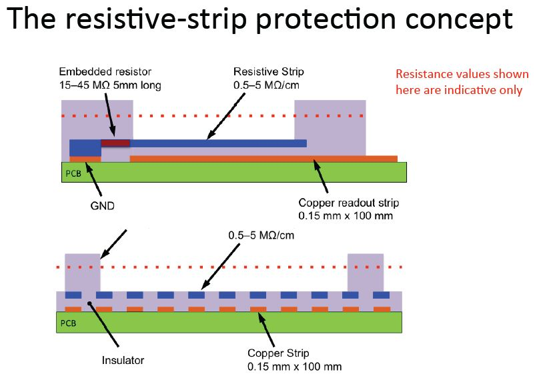
Standard vs Resistive Micromegas Sparking
Standard MM could not be operated in neutron beam
HV break-down and currents > several µA for gains ~ 1000–2000
MM with resistive strips worked perfectly well
No HV drops, small spark currents
up to gains of 2 x 10⁴
Resistive MM
Standard MM
Since 2010: Resistive Micromeas technology
Problem was solved by adding a layer of resistive strips above the readout strips
Spark neutralization/suppression
(sparks still occur but become inoffensive)

Slide 17
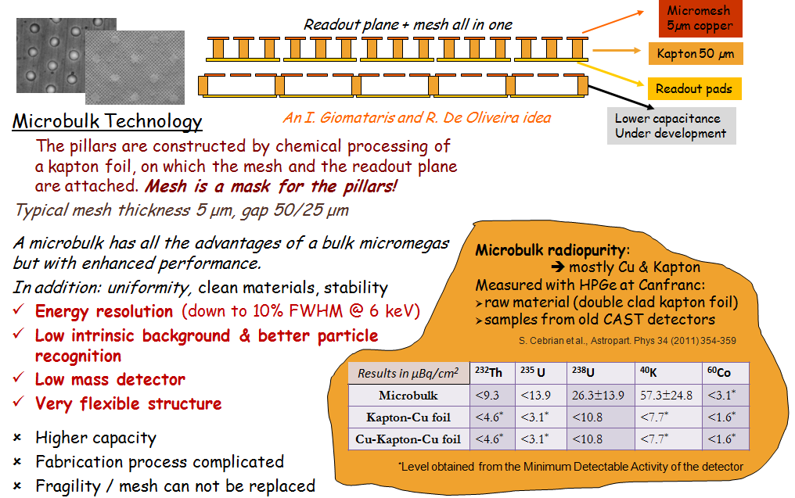
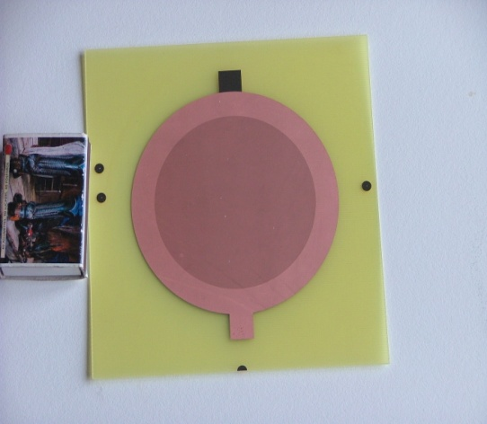
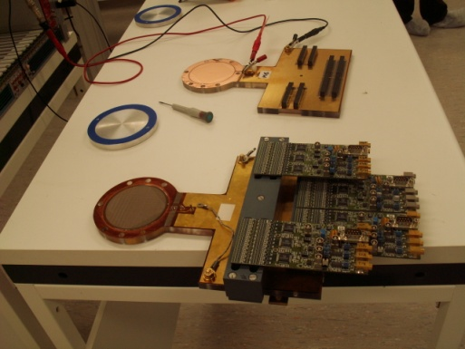
« MicroBulk » Micromegas

Slide 18






Ingrid
X-Rays
α-particles
“Octopuce” (8 Timepix ASICs):
INSTRUMENTATION FRONTIER:
PIXEL READOUT OF MPGDs –
Ultimate Gas-Silicon Detector Integration
Triple GEM stack + Timepix ASIC (5 GeV e-):
1.5 cm

Slide 19






Pixel Readout of MPGDs: “InGrid” Concept
“InGrid” Concept: By means of advanced wafer processing-technology INTEGRATE
MICROMEGAS amplification grid directly on top of CMOS (“Timepix”) ASIC
3D Gaseous Pixel Detector → 2D (pixel dimensions) x 1D (drift time)
“InGrid”:
~ 50 μm
Protection Layer (few μm)
against sparks
Medipix2 / Timepix ASIC

Slide 20




“InGrid’ Technology and “Driving” Developments
2005: Single “InGrid” Production
Since 2011: Major Step Forward →
InGrid Production on a wafer level (107 chips)
2009: “InGrid” Production on a
3 x 3 Timepix Matrix

Slide 21





Photosensitive Detector: Integrating Ingrid and CMOS readout
MICROMEGAS (InGrid)
covered with CsI
photon
CsI PC
Ingrid without CsI
UV absorbed
by the
fingerprint
on the window
M. Fransen, RD51 Mini-Week, Sep. 23-25, 2009, WG2 Meeting
TIMEPIX:
Ingrid with CsI PC:
2D UV Image
of a 10mm
diameter mask
Chip area: 14x14mm².
(256×256 pixels of 55×55 μm²)
Chip area: 14x14mm².
(256×256 pixels of 55×55 μm²)

Slide 22




MPGD-Based Gaseous Photomultipliers (GPM)
GEM Gaseous Photomultipliers (GEM+CsI photocathode) to detect single photoelectrons
Semitransparent
Photocathode (PC)
Reflective
Photocathode (PC)
Multi-GEM Gaseous Photomultipliers:
Largely reduced photon feedback
(can operate in pure noble gas & CF₄)
Fast signals [ns] → good timing
Excellent localization response
Able to operate at cryogenic T
CsI ~ 500 A
CsI ~2500 A
Single Photon Time Resolution:
Single Photon Position Accuracy:
CF₄
770 torr
200 µm
3 GEM
σ = 1.6 ns
Intrinsic accuracy
σ (RMS) ~ 55 µm
FWHM ~160 µm
Beam ~ 100 µm
Micromegas: σ ~ 0.7 ns with MIPs
E.Nappi, NIMA471 (2001) 18; T. Meinschad et al, NIM A535 (2004) 324; D.Mormann et al., NIMA504 (2003) 93

Slide 23


Thick-GEM Multipliers (THGEM)
Simple & Robust → Manufactured by standard PCB techniques
of precise drilling in G-10 (and other materials) and Cu etching
STANDARD GEM
10³ GAIN IN SINGLE GEM
THGEM
10⁵ gain in single-THGEM
Other groups developed
similar hole-multipliers:
Optimized GEM:
L. Periale et al.,
NIM A478 (2002) 377.
LEM: P. Jeanneret,
PhD thesis, 2001.
1 mm
0.1 mm rim
to prevent
discharges
Double THGEM or THGEM/Micromegas
Effective single-electron detection
(high gas gain ~10⁵ (>10⁶) @
single (double) THGEM)
Few-ns RMS time resolution
Sub-mm position resolution
MHz/mm² rate capability
Cryogenic operation: OK
Gas: molecular and noble gases
Pressure: 1mbar - few bar
1,0E+07
1,0E+06
10⁶
1,0E+05
1,0E+04
Gain
1,0E+03
1,0E+02
1,0E+01
MM = 330 NeCF4 10%
1,0E+00
MM = 290 NeCF4 5%
DTHGEM NeCF4 10%
1,0E-01
DTHGEM NeCF4 5%
1,0E-02
0
200
400
600
800
1000
Δ
C. Azevedo et al.; arXiv: 0909.3191
V THGEM (V)

Slide 24




THGEM Photon Detectors for RICH: Efficiency Evaluation
Single PE
collection efficiency
into THGEM holes:
PE efficiency
extraction
into the gas
vs vacuum:
Azevedo et al., arXiv:0909.5357

Slide 25















MPGD-Based Cryogenic Avalanche Detectors: Concept Gallery
L.Periale et al, IEEE TNS 52 (2005) 927
A.Bondar et al, NIMA 556 (2006) 273
A.Rubbia, J. Phys. Conf. Ser. 39 (2006) 129
A.Buzulutskov et al, IEEE TNS 50 (2003) 2491;
A.Bondar et al, NIMA 524 (2004) 130
P.K.Lightfoot et al, JINST 4 (2009) P04002
N.McConkey et al, IPRD 2010, Siena, Italy; Nucl. Phys. B Proc. Suppl. 215 (2011) 255
Y.L.Ju et al, Cryogenics 47 (2007) 81
M.Gai et al, Eprint arxiv:0706.1106 (2007)
A.Bondar et al, JINST 3 (2008) P07001
A.Buzulutskov, A.Bondar, JINST 1 (2006) P08006
A. Bondar et al, JINST 5 (2010) P08002
A.Buzulutskov et al, EPL 94 (2011) 52001
D.Akimov et al, JINST 4 (2009) P06010
S. Duval et al, JINST 4 (2009) P12008
D.Akimov, NIMA 628 (2011) 50
S. Duval et al, JINST 6 (2011) P04007

Slide 26





Micro-Pixel Chamber (μPIC) at Kobe University
μ-PIC：micro pixel gas chamber
Area: 10x10cm – 30x30cm
Readout pitch :400μm
Production using PCB technology
NEW: μ-PIC design with resistive
cathode:
Cathode patterns are formed by resistive material.
Large current from spark reduce the e-field, and spark will be quenched.
This design provide one promising possibility of MIP detector under hadronic background
Invented by A.Ochi, T.Tanimori (NIMA471 (2001) 264)
Application: X-ray imaging, Gamma camera,
Medical RI tracing
Surface pictures of resistive μPIC:

Slide 27







Why Micro-Pattern Gaseous Detectors are so attractive …
High Rate Capability
High Gain
High Space Resolution
Good Time Resolution
Good Energy Resolution
Excellent Radiation
Hardness
Ion Backflow Reduction
Photon Feedback
Reduction
GEM
2x10⁶ Hz/mm²
GEM
Micromegas
σ_{space} ~ 15-40 μm
GEM
σ _{time} ~ few ns
Micromegas
One of the recent reviews describing
the progress of the RD51 collaboration:

Slide 28
Historical Roadmap of the MPGD Technologies and RD51 Collaboration
MicroMEGAS (CEA Saclay, Y. Giomataris)
RD51
collaboration
MSGC (ILL, A. Oed)
GEM (CERN, F. Sauli)
RD28
1988
1996
1992
1997
2003
LEM (Periale)
THGEM(Chechik)
2008
1996
2000
2005
InGrid
μ-PIC (A. Ochi, T. Tanimori)
Capillary plate (Yamagata U., H. Sakurai)
Many of the Micro-Pattern Gaseous Detector Technologies were introduced before
the RD51 Collaboration was founded
With more techniques becoming available (or affordable), new detection concepts
are being introduced and the existing ones are substantially improved

Slide 29


The main objective is to advance MPGD technological development and associated electronic-readout systems, for applications in basic and applied research”: http://rd51-public.web.cern.ch/rd51-public
10
58
15
3
Large Scale R&D program to advance MPGD Technologies
Access to the MPGD “know- how”
Foster Industrial Production
More than 80 groups
More than 400 people
National and International Laboratories
National Institutes and Universities

Slide 30
Summary of the RD51 Achievements (2008 – 2013)
Consolidation of the Collaboration and MPGD Community Integration (> 80 institutes, 450 members);
Major progress in MPGD Technologies: Large area GEM (single mask), Micromegas (resistive) and THGEM; picked up by experiments, including LHC upgrades;
Secured future of the MPGD Technologies development through the TE MPE workshop upgrade and FP7 AIDA contribution
Contacts with industry for large volume production; MPGD industrialization and first industrial runs
Major improvement to the MPGD simulation software framework for small-scale structures for applications;
Development of common, scalable readout electronics (SRS); many developers and > 50 user groups; Production (PRISMA company and availability through CERN store); Industrialization (re-design of SRS in ATCA in EISYS)
Infrastructure for common RD51 test beam and facilities (> 20 user groups);

Slide 31
















Future RD51 Collaboration Activities (beyond 2013)
Large Area Detectors
Assembly Optimization
RD51 Common Projects
Generic R&D, QA
Long Term Stability
WG2:
WG1:
WG5:
Software Tools and
Simulations
MPGD Electronics
RD51
WG4:
WG3/NEW WG:
WG7:
WG6:
Conferences / Schools
Academia-Industry
Matching Events
CERN MPGD
Workshop,
Quality Control
and Industrialization
RD51 Common
Test Beam and Lab Facilities

Slide 32


MPGD Technologies for Energy Frontier (HL-LHC, LC)
 | Vertex | Inner Tracker | PID/ photo- det. | EM CALO | HAD CALO | MUON Tracking | MUON Trigger
ATLAS |  |  |  |  |  | Micromegas | Micromegas
CMS TOTEM |  |  |  |  | Backing-HE (GEM, MM) | GEM GEM | GEM GEM
LHCb |  |  |  |  |  |  | GEM
ALICE |  | TPC (GEM)
Linear Collider |  | TPC(MM,GEM, InGrid) |  |  | DHCAL(MM,GEM,THGEM)
ATLAS Micromegas:
On a road to large-area detectors:
(1.2 * 0.6 m²)
CMS GEM:
Trapezoidal GEM Prototype (99 x 45-22 cm2)

Slide 33













WG1: Examples of CERN/LHC Upgrades (“large achievement for MPGD community”)
ALICE (GEM)
ATLAS NSW (Micromegas)
Elba 2015
Elba 2015
LHC Upgrades: Original R&D efforts emerged from RD51 activities.
Today: production phase under the project effort , access to RD51 facilities (laboratory, test beam, workshops) and tools (simulation, electronics,…) to facilitate this particular phase

Slide 34












WG1: Examples of CERN/LHC Upgrades (“large achievement for MPGD community”)
COMPASS RICH-1 (THGEM+MM)
CMS (GEM)
Elba 2015
Elba 2015
LHC Upgrades: Original R&D efforts emerged from RD51 activities.
Today: production phase under the project effort , access to RD51 facilities (laboratory, test beam, workshops) and tools (simulation, electronics,…) to facilitate this particular phase

Slide 35



Resistive Micromegas Performace: Resolution vs Track Angle
Using charge amplitude (Centroid hit)
Spatial resolution rapidly decreases for inclined
tracks if the cluster centroid (e.g., charge weighting)
is used; small strip pitch does not help
Using time information (TPC segment)
Measuring the arrival time of the signals opens a new dimension; in this case the MM functions like a TPC
=> Track vectors/plane for inclined tracks
Combination of centroid & TPC →
spatial resolution < 100 μm independently of track incident angle !
Spatial resolution vs magnetic field:
J. Wotschack
Range of track angles in NSW

Slide 36



Micromegas for ATLAS NSW: Full Sector Mechanical Prototype (CERN)
Test of segmented FR4 skin glueing with different stiffeners
Will serve for deformation studies
1.8 m
3.7 m
Stress and deflection test
J. Wotschack

Slide 37








GEM Technology: From GE 1/1 to GE1/1-v6 Prototypes
2010
2011
2012
2013
2014
2014/2015
Generation I
The first 1m-class detector ever built but still with spacer ribs and only 8 sectors total.
Ref.: 2010 IEEE (also RD51-Note-2010-005)
Generation II
First large detector with 24 readout sectors (3x8) and 3/1/2/1 gaps but still with spacers and all glued.
Ref.: 2011 IEEE. Also RD51-Note-2011-013.
Generation III
The first sans-spacer detector, but with the outer frame still glued to the drift.
Ref.: 2012 IEEE N14-137.
Generation IV
First detector with complete mechanical assembly; no more gluing parts together!
MPGD 2013;
and IEEE2013.
Generation V
Nearly final CMS
design: stretching apparatus that is now totally inside gas volume. Ongoing test beam campaign for final performance measurements.
Generation VI
Latest detector design; to be installed in CMS. Optimized final dimensions for max. acceptance and final eta segmentation. Ongoing test beam campaign for DAQ
GEM foil production uses single mask technology for wet etching
  Dramatically reduces foil production costs and allows large sizes to be manufactured
NS2 assembly technique developed
  Construction time reduced from week(s) to two hours per chamber
A. Sharma

Slide 38









Consolidation of existing structures: Cylindrical MPGDs as an example
E. Oliveri

Slide 39



MPGD Readout for the Time Projection Chamber at the ILC/CLIC
MPGDs are foreseen as TPC readout for ILC
or CLIC (size of endcaps of ~ 10 m²):
Standard “pad readout” (1x 6 mm²): 8 rows of det. modules (17×23 cm2); 240 modules per endcap
“Pixel readout” (55x 55μm²): ~100-120 chips per module → 25000-30000 per endcap
ILCTPC with MPGD-Readout:
(spatial resolution < 100 μm @ 5T)
Laser-etched GEMs 100µm thick (‘Asian GEMs’)
Wet-etched triple GEMs
Resistive MM with dispersive anode
GEM + pixel readout
InGrid (integrated Micromegas grid with pixel readout)
Backgrounds in
CLIC TPC requires
very small pixels
(< 1x1 mm²)
CLIC TPC
Simulation
(M. Killenberg)

Slide 40











MPGD-based “Pad Readout” for ILC TPC
Efforts to improve the modules design for all technologies. Several test beams campaigns:
7 Micromegas modules with 2-phase C02 cooling
With beam and laser dots:
UV laser gererates MIP tracks
& illuminate calibration spots
2P CO2
Cooling
Large TPC Prototype with versatile endplate @ DESY
Diameter 77cm
Goal for final TPC can be reached:
GEM / MM performance similar
MM (B=0): Before correction
MM (B=0): After correction
(note – different scale)

Slide 41




MPGD-based “Pixel Readout” for ILC TPC
LARGE AREA: 160 InGrid detector setup
→ 3 modules: 1 x 96 InGrid, 2 x 24 InGrids
→ Readout 5 SRS FECs
By design:
Singe electron detection
Time-of-arrival measurement
High granularity; Uniform gas gain
Module with
96 InGrids
on 12 „octoboards“
Preliminary data analysis:
Track reconstruction
→ straight and curved tracks
→ ≈ 3000 hits per 50 cm track
Physics properties of the TPC
→ field distortions; reliability
→ dE/dx resolution;delta identification
→ single point resolution
→ momentum measurement
M. Lupberger
24 InGrid installation in LP
LP endplate with 3 modules

Slide 42





COMPASS RICH I Upgrade: Long-Term Experience, Performance
COMPASS RICH I:
UPGRADE OF COMPASS RICH I:
PMTs not adequate because of large angular acceptance ➔ only small demagnification
factor of optical system allowed (large distortions); 5 m2 of PMTs not affordable.
1999-2000: 8 MWPC with CsI (RD26 @ CERN)
MPGD-Photon Detectors are the best option
F. Tessarotto
→ Micromegas +THGEM, the hybrid architecture
structure, is one of the most advanced scheme:
After a long-term fight for increasing electrical stability
at high rates: robust operation is not possible at gain~10⁵ because of photon feedback, space charge & sparks
beam off: stable
operation up to > 2300 V
beam on: stable operation
possible only up to ~2000 V
2006: 4 central CsI+cathodes:
remove and insert frames with
MAPMTs and lense telescopes
PMTs not adequate → only small demagnification
factor allowed; 5 m² of PMTs not affordable.
Higher performance reached with the MM + THGEM
architecture (than multiple-THGEM structures)

Slide 43





LEM (THGEM) Technology for Double Phase Ar-TPC
Double-phase Ar LEM TPC

Slide 44













WG2: Generic R&D, Examples of New Ideas, Applications
Calorimetry with MPGD:
Fast Timing:
New Materials (Glass GEM):
Elba 2015
O2/2015
≈50phe
Preliminary
≈50phe
Elba 2015
The Latest Results of Crystalized Glass GEM, Y. Mitsuia, RD51 miniweek (GDD/RD51 lab)
E. Oliveri
Resistive Material:
Large Area Thin Detectors:
Neutrons Detection:
B10
Elba 2015
Gd
O3/2015
O8/2014 KUBEC Workshop
European Spallation Source (ESS)

Slide 45

WG2: Generic R&D, Examples of New Ideas
FAST-TIMING MPGDs on MM concept:
Study of charge-transfer properties through
graphene for gas detector applications:
S. White, DESY Seminar,
June 12, 2015
Elba 2015
F. Resnati
Preliminary
≈50phe
≈50phe
Convert single-photoelectron time jitter
of a few hundred picoseconds into an incident-particle timing response of the order of 50 ps

Slide 46





WG2: Generic R&D, Tracking/Calorimetry Applications
RESISTIVE MICROMEGAS: Resistive layers are known to quench sparks at early stage
  “Horizontal” evacuation of charge → might be too slow for large areas
  Segmented R-layer to limit physical crosstalk
Optimisation:
→ reduce resistivity
and evacuation time
but still suppress sparking
– “Vertical” evacuation
of charge using buried
resistors, proposed
by Rui de Oliveira
– Ongoing program:
Vary the RC, measure
the linearity (rate &
dE/dx scans),
check sparking
Work by LAPP Annecy, NCSR Demokritos , Univesrity of Athens, CEA IRFU
Star
Mirror
Snake
M. Chefdeville, T. Geralis
Real R1 values:
400 -750 KOhms
with 100KΩ/Sq
Real R1 values:
4 MOhms with 100KΩ/Sq
Real R1 values:
40 MOhms With 100KΩ/Sq

Slide 47







WG2: R&D Continuation - Quality Control
Electrical rigidity
Hole diameter uniformity in GEM
Gap uniformity in MicroMegas
THGEM thickness uniformity
Final detector calibration and characterization protocols and infrastructure

Slide 48



WG2: Radiation Hardness Studies - Long Term Stability
Portable gas monitoring
system for detector stability
studies
→ to be used by LHCb and
CMS upgrade for the
muon system
Classical gas detectors ageing detector
Radiation hardness and activation of detector components
Sustainability to neutrons and heavily ionizing particles induced discharges
Exposure to X-Ray, Gamma, Neutron and Alpha Sources
Monitoring infrastructure
Radiation hardness of MPGDs is comparable with solid-state
Sensors in harsh radiation environments
→ still, it is important to develop and validate materials
with resistance to ageing and radiation damage.
Discharge studies of the triple GEM detector exposed to the low energy neutron flux
Resistive MicroMegas
stability performance
under X-Ray irradiation

Slide 49











WG3: RD51 Academia – Industry Matching Events
Platform: Research + industry + potential users to foster collaboration on dedicated applications
Neutron Detection 1st
Neutron Detection 2nd
Photon Detection
16-17 March 2015
10-11 June 2015
14-15 October 2013
https://indico.cern.ch/event/392833/
(understanding requirements, applications, approaching new communities and technologies)
https://indico.cern.ch/event/265187/
https://indico.cern.ch/event/365840/
Summary (arXiv 1410.1070)
Press release

Slide 50












WG3: RD51 Academia – Industry Matching Events: Neutrons & MPGDs
There is tangible mutual interest between the HEP and neutron-scattering communities
to advance the technology of MPGDs:
GEM-based solutions for thermal-neutron detection at spallation sources,
novel high-resolution neutron devices for macromolecular crystallography,
fast neutron MPGD detectors in the fusion
represent a new frontier for future developments.
A large Community - Strong interaction with RD51
Use of MPGD Detector R&D, tools and electronics (RD51 SRS & ATLAS NSW VMM)

Slide 51








WG3: RD51 Collaboration & International Schools
RD51 Organized Events:
The vitality of the MPGD community
resides in the relatively large number
of young scientists
educational events constitute an
important activity.
MPGD assembly
2009
MPGD simulation
RD51 MPGD Lectures:
  MPGD students lectures (1 week) at the International Workshop on Advance Detectors & RD51 CM in Kolkata
2011
MPGD electronics
2013
RD51 participated in XII ICFA School (Bogota, Colombia)
October 2014
2013
RD51 participated in Danube School on Instrumentation (Novi Sad Serbia)
2014 (Novi Sad)

Slide 52






Spin off is important key word for the HEP labs to survive …
Cosmic Ray Muon Tomography
Using GEMs for Homeland security
T2DM2: Temporal Tomography
Densitometric by the Measure of Muons
Technology
RD51
Technology
Liquid xenon detectors for functional medical imaging
CsI-RETGEM for UV
flame detection
Applications area will benefit from the technological developments developed by the RD51
The responsibility for the completion of the application projects lies with the institutes themselves

Slide 53

WG4: MPGD Simulation Tools
Focus on providing techniques for calculating electron transport in small-scale structures
The main difference with traditional gas-based detectors is that the electrode scale
(~ 10 μm) is comparable to the collision mean free path
Microscopic Tracking (Development and Maintenance of Garfield++):
Garfield++ is a collection of classes for the detailed simulation of small-scale detectors.
Garfield++ contains:
- electron and photon transport using cross sections provided by Magboltz
- ionisation processes in gases, provided by Heed and MIP
- ionisation and electron transport in semi-conductors
- field calculations from finite elements, boundary elements, analytic methods
Simulation Improvements:
→ Transport:
- ion mobility and diffusion, measurement and modelling
- Magboltz cross sections (Ar, Xe, He, Ne; GeH₄, SiH₄, C₂H₂F₄ ) are frequently
updated in collaboration with LXCAT (http://www.lxcat.laplace.univ-tlse.fr)
- e-ion recombination process in Xe
- thermal motion
→ Photons:
- update in UV emission
- inclusion of IR production
- photon trapping and resulting excitation transport
- photon absorption in the gas (gas feedback)
- photon absorption in and electron emission from walls (feedback)
- photo cathodes

Slide 54





WG4: MPGD Strong Simulation Efforts in Very Specific Needs
Applications:
GEM: multiplication process and polyimide properties; charging up effects
MicroMegas: timing and effects of resistive layers;
→ ATLAS NSW upgrade: study of electron losses in MM with different mesh specifications
TPC GEM: ion backflow
→ ALICE TPC upgrade: rate dependence of the Ion Back Flow in GEM
Simulation
Measurement

Slide 55

WG4: GEM Charging-Up Effects Simulation
Electric Field Intensity during
the charging-up process:
each iteration correspond to
the number of primary electrons that already reached to the hole
ANSYS: field model
Magboltz 9.0.1: relevant
cross sections of electron-matter interactions
Garfeld++: simulate
electron avalanches
Charging effects are much smaller after (100 – 150) *10⁵ avalanches
→ GEM gas gain stabilizes

Slide 56







WG5: The RD51 Scalable Readout System (SRS) for MPGD
RD51 Development / Industrialization: portable multi-channel readout system (2009-2012)
Scalable readout architecture: from ~ 100 channels up to very large LHC systems (> 100 k ch.)
Project specific part (ASIC) + common acquisition hardware and software
Physical Overview of SRS:
Scalability from small to large system
Common interface for replacing the chip
frontend
Integration of proven and commercial
solutions for a minimum of development
Default availability of a very robust and
supported DAQ software package
Cheap! < 2 € / ch + FE
RD51 SRS is very successful → already used outside MPGD field (e.g. SiPM readout)
TODAY: # of SRS systems deployed ~ 100 with > 300 k APV channels,
total volume of SRS sales ~ 1 MCHF
ADC frontend adapter
for APV and Beetle chips
ADC plugs into FEC to
make a 6U readout unit for
up to 2048 channels
FEC cards (common):
Virtex-5 FPGA, Gb-Ethernet, DDR buffer, NIM and LVDS pulse I/O, High speed Interface connectors to frontend adapter cards
Frontend hybrids:
based on
APV25, VFAT, Beetle, VMMx and Timepix
chips

Slide 57
















WG5: The RD51 Scalable Readout System (SRS) for MPGD
SRS & APV25 FE chip
SRS: Different System
Worldwide use in the RD51 community (>2000 hybrids)
SRS for R&D on Detectors
SRS+SiPM (NEXT TPC)
E. Oliveri
Ongoing – Baseline
Continuously upgrading
SRS-FEC+TOTEM DAQ
Closed to commissioning in UCS
SRS for experiments (ATCA)
SRS+Timepix (LC-TPC) – Bonn/Desy
Ongoing - scaled up
Finalization of SRS ATCA
2015
Very appealing for the future: VMM (NSW ATLAS FE chip)
SRS for spatially distributed
system (optical SRS)
Baseline solution for RD51 SRS community.
Interest and support from ESS (European Spallation Source) and ALICE FOCAL
RD51 involvement since 2014
Half Done (started early 2014)
http://indico.cern.ch/event/356113/session/6/contribution/29/material/slides/1.pdf

Slide 58




WG6: MPGD Technology & Production @ CERN
Interesting Workshop Overview Capabilities
New Capabilities….
OK
Antonio Teixeira
OK
OK
OK
https://indico.cern.ch/event/352483/
OK
OK
installation of the new infrastructure (to fabricate 2x1m² Bulk MM & 2x0.5m² GEM) COMPLETED
MPGD Projects….
Construction of the new workshop’s building:
Start : beginning 2012
End: end 2017

Slide 59




WG6: MPGD Technology Industrialization
Technology Industrialization → transfer “know-how” from CERN workshop to industrial partners
GEM Technology (contacts):
Mecharonix (Korea, Seoul)
Tech-ETCH (USA, Boston)
Scienergy (Japan, Tokyo)
TECHTRA (Poland, Wroclaw
THGEM Technology (contacts):
ELTOS S.p.A. (Italy),
PRINT ELECTRONICS
GEM Licenses signed by:
Mecharonics, 21/05/2013
TECH-Etch, 06/03/2013
China IAE, 10/01/2012
SciEnergy, 06/04/2009
Techtra, 09/02/2009
CDT, 25/08/2008
PGE, 09/07/2007
MicroMegas Technology(contacts):
ELTOS S.p.A. (Italy)
TRIANGLE LABS(USA, Nevada)
SOMACIS (Italy, Castelfidarco)
ELVIA (France, CHOLET)
GEM Industrialization Status (June 2015):
Micromegas Industrialization Status (June 2015):
TECH-ETCH
Single Mask process fully understood. Many 10cm x 10cm produced and characterized.
40cm x 40cm GEM successfully produced
CMS GE1/1 size of 1m x 0.5m started
TECHTRA
Production Line Operational
Stable process for 10cm x 10cm
Single Mask process completely understood – 10cm x 10cm produced
30cm x30cm Single Mask Produced
MECHARONICS
10cm x 10cm double mask produced and tested
30cm x 30cm double mask under evaluation @ CERN
CMS GE1/1 size of 1m x 0.5m started
ELVIA
Bulk Micromegas detectors are routinely produced with sizes up to 50cm x 50 cm.
Contract for ATLAS NSW module-0 signed
Tendering process for full production ongoing
ELTOS
Many small size bulk Micromegas detectors have been produced.
Contract for ATLAS NSW module-0 signed
Tendering process for full production ongoing
ATLAS NSW upgrade → will first detector mass-produced in industry
using a large high-granularity Micromegas:
det. area ~1300 m2 divided into 2 m x 0.5 m2 units

Slide 60




WG7: PH-GDD Laboratory … Laboratory available for RD51 Collaboration
Continuously running…..” twenty-four seven”
Permanent installations (Today): ALICE, ATLAS, ESS
CMS moved roughly two years ago to TIFF, access to the lab for specific measurements
More than 15/20 groups per year coming to perform measurements
E. Oliveri
Technical support
MPGD Detectors
Gas system and services
Readout electronics (std and custom RD51 SRS&APV)
Radioactive Sources
Interface with CERN services
(RP, gas, metrology, irradiation facilities,…)
Clean Rooms
Mechanical and Electronic Workshop

Slide 61












WG7:Semi-Permanent Test Beam Infrastructure in the SPS line
Three periods of two weeks each per year
About fifteen-twenty users per year
Building 887 – EHN1
H4 (PPE134)
Goliath Magnet (1.4 T)
→ Ship Experiment?
E. Oliveri
2014 test Beam
December 2014
CMS (GEM)
WIS/A/C(WELL, THGEM)
ATLAS NSW (mm)
BESS III & SHIP (GEM)
LAPP/DEM/IRFU(mm)
ALICE TPC (GEM and mm)
2008-2015: ~ 40 RD51 groups participated (2015 test Beam: May-June, July, October)

Slide 62





IWAD conference &
RD51 Collaboration Meeting
October 2015 (Trieste)
October 2014 (Kolkata)
MPGD conferences & RD51CM
2009
2011
2013

Slide 63
RD51 and the Rise of Micro-Pattern Gas Detectors
A fundamental boost is offered by RD51: from isolate MPGD developers to a world-wide net
A combined map of organizations working
with MPGDs built with collaboration-spotting software developed at CERN
→ huge growth in interest in the MPGD
technologies
Collaboration Spotting Software:
http://collspotting.web.cern.ch/)
J.-M. Le Goff

Slide 64
RD51 and the Rise of Micro-Pattern Gas Detectors
GEM
GEM
1998
2014
Micromegas:
Micromegas:
1998
2014
J.-M. Le Goff

Slide 65
CERN Courier, October 2015

Slide 66




Gaseous Tracking: Detector-Electronics Integration Trends
Wire Chambers, TPC, RPC → MPGD (GEM, Micromegas) → InGrid (3D)
YESTERDAY:
INTEGRATION
TODAY:
INTEGRATION
FUTURE:
Micromegas:
HL-LHC
ILC
ILC
CLIC
LHC
Ingrid
High rate capability ~10⁶ Hz/mm²
Spatial res. ~ 30-50 μm (TRACKING)
Time res. ~ 3-5 ns (TRIGGER)
Advances in photolithography →
Large Area MPGDs (~ m² unit size)

Slide 67
Instead of Outlook … MPGD Performance Summary
MPGD Characteristics | Gas Electron Multipliers (GEM) | Micromegas/ Resistive MM
Active areas (Size of single detector module) / Large Scale Industrial Production | ~ 1 x 0.5 m² yes | ~ 2 x 1 m² yes
Radiation Hardness | > 10 HL-LHC years | > 10 HL-LHC years
High-Rate Capability | ~ 50 MHz/cm² | Res MM (MHz/cm²): ~ 0.1 (today) ~ 10 - 50 (future)
Spatial resolution | <~30 μm (single layer) | <~30 μm (single layer) ang. dep.: μTPC
Tracking efficiency | 99% | 98%
Triggering efficiency (25 ns timing and B-field) | 95-98% | 95-98%
Timing Resolution | ~4-5 ns (MIP) & CF₄ how to improve (?) | 3-5 ns (MIP) & CF₄ how to improve (?)
MPGDs have also found numerous applications → they are being used or considered:
X-ray and neutron imaging, neutrino–nucleus scattering experiments, dark- matter
and astrophysics experiments, plasma diagnostics, material sciences, radioactive-waste
monitoring and security applications, medical physics and hadron therapy.

